Slide 1

Differential Privacy in Personalized Pricing with
Nonparametric Demand Models
Xi Chen
Leonard N. Stern School of Business, New York University
Sentao Miao
Desautels Faculty of Management, McGill University
Yining wANG
Naveen Jindal School of Management, University of Texas At Dallas
Link: https://papers.ssrn.com/sol3/papers.cfm?abstract_id=3919807

Slide 2

Personalized data-driven decision making
Classical decision-making process:
Estimation &
Optimization
Decision to each
arriving customer
User Data

Slide 3

Classical decision-making process does not preserve privacy
Black-box algorithm
Estimation &
Optimization
Decision to each
arriving customer
User Data
(sensitive historical data)
Algorithm return a policy
based on historical data
Attacker pretends
to be a customer
Attacker infers historical data

Slide 4
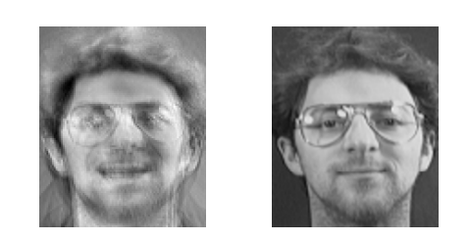
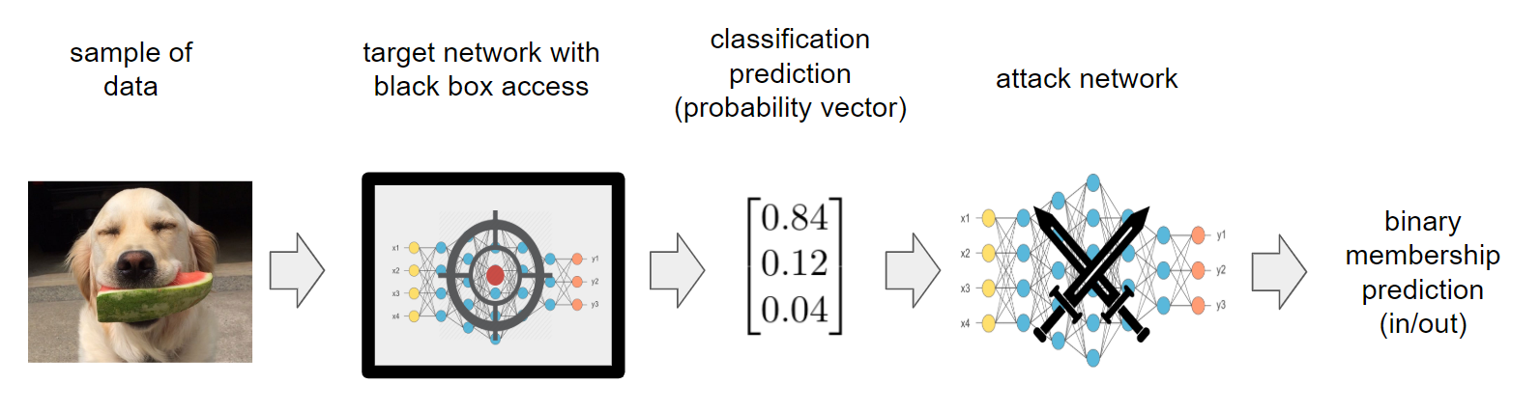
Various methods of privacy attack
Model Inversion: use output of the algorithm to recover customer’s data (i.e., input) (Fredrikson et. al. 2014)
Membership Inference: from the output to infer whether a specific person is in the dataset (Shokri et. al. 2017)
Recovered from model inversion attack (left) and the actual image (right)
(Fredrikson et. al. 2015)

Slide 5
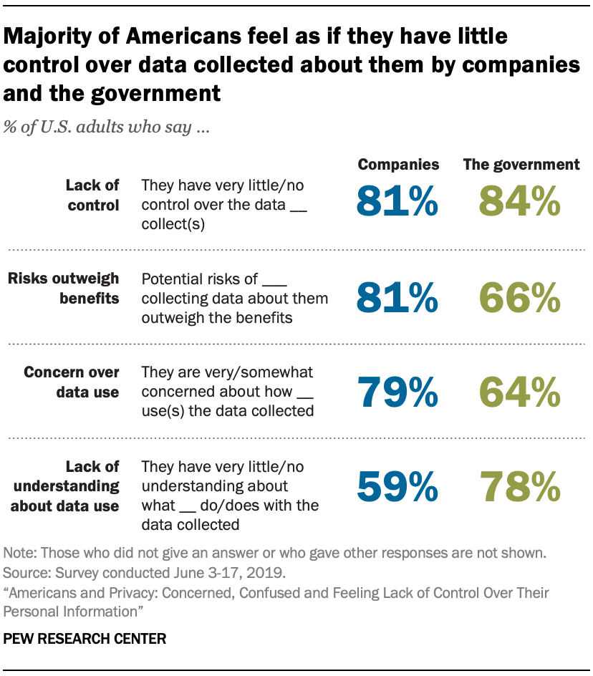
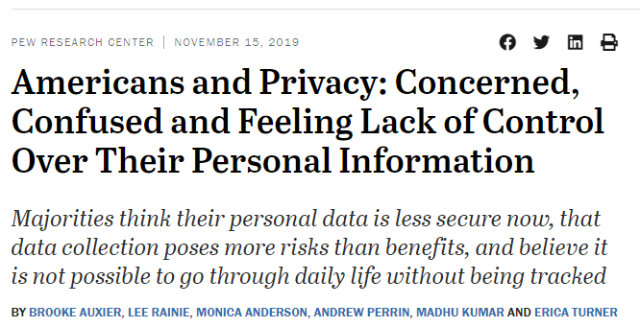
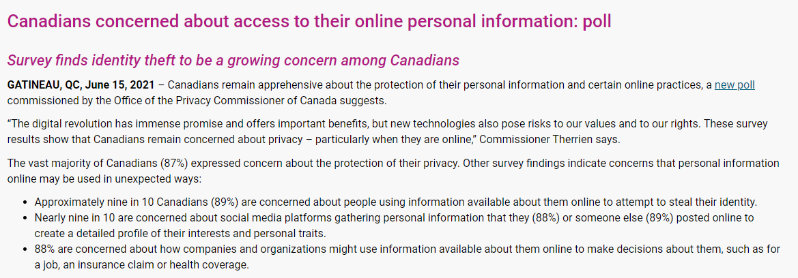
Growing public concern about data privacy

Slide 6
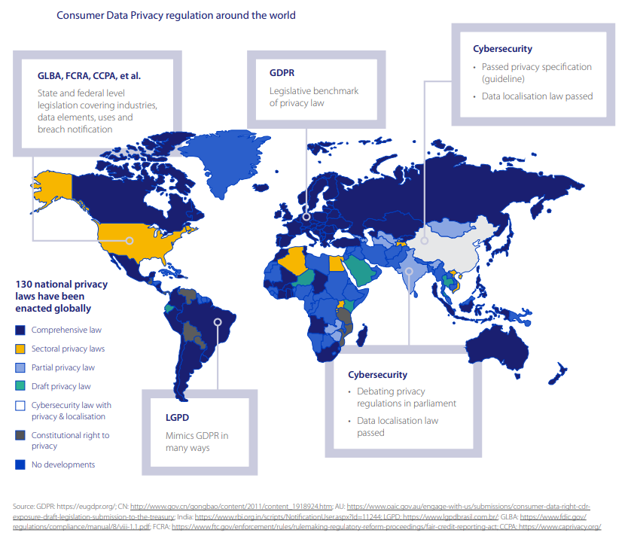
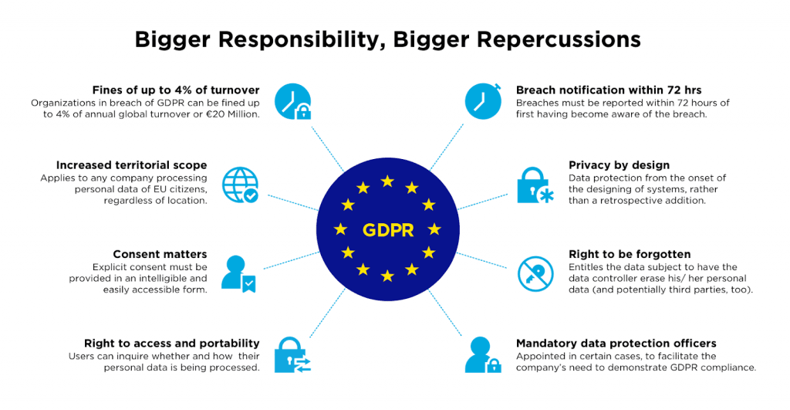
Legislation action to protect data privacy
The focus of this research is to design privacy-preserving algorithms for decision making.

Slide 7
This work designs privacy-preserving dynamic pricing algorithms
Setting of this paper:
Dynamic personalized pricing of single product with sequentially arriving customers.
Demand is unknown a priori and nonparametric.
Algorithms need to preserve privacy in a rigorously defined notion.

Slide 8
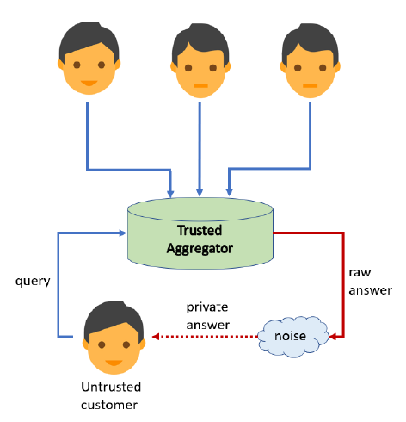
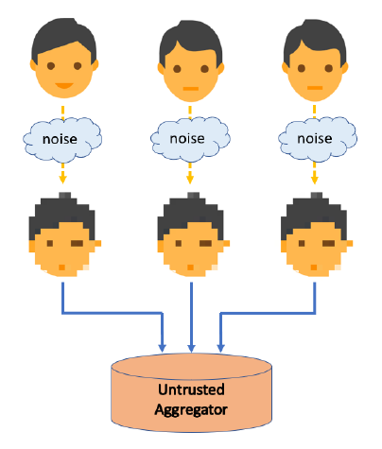
Differential Privacy: rigorously defined notions of privacy-preserving criteria
Intuitively, differential privacy (DP) guarantees that the attacker cannot notice the difference (with high probability) if any customer’s data in the dataset is replaced by another.
There are two types of DP: central DP (CDP) and local DP (LDP).
CDP: attacker in any time is unlikely to infer data of any earlier customer
LDP: even the platform can only use privatized data

Slide 9
Differential Privacy: rigorously defined notions of privacy-preserving criteria
Intuitively, differential privacy (DP) guarantees that the attacker cannot notice the difference (with high probability) if any customer’s data in the dataset is replaced by another.
There are two types of DP: central DP (CDP) and local DP (LDP).
Today’s presentation focuses on LDP.
We have algorithm with CDP in our paper.
CDP: attacker in any time is unlikely to infer data of any earlier customer
LDP: even the platform can only use privatized data

Slide 10





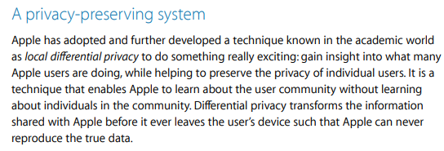
DP has been widely applied in the industry already

Slide 11
Literature review
Dynamic pricing and revenue management with demand learning.
  For example, Chen et al. 2015, Qiang and Bayati 2016, Bernstein et al. 2019, Javanmard and Nazerzadeh 2019, Bastani and Bayati 2020, Cohen et al. 2020, Chen and Gallego 2021.
Data privacy of algorithm and policy.
  In computer science: Dwork et al. 2006, Chan et al. 2011, Dwork & Roth 2014, Mishra & Thakurta 2015, Ren et al. 2020, Zheng et al. 2020, Han et al. 2021.
  In operations management: Xu 2018, Tsitsiklis et al. 2020, Hu et al. 2020, Xu et al. 2021, Lei et al. 2021, Chen et al. 2021

Slide 12

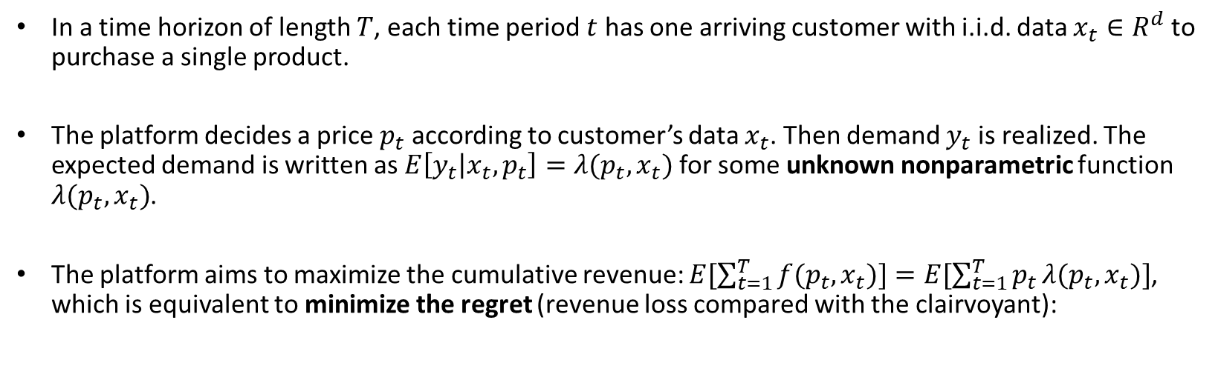
Model setup and assumptions
In a time horizon of length $T$, each time period $t$ has one arriving customer with i.i.d. data $x_{t}∈R^{d}$ to purchase a single product.
The platform decides a price $p_{t}$ according to customer’s data $x_{t}$. Then demand $y_{t}$is realized. The expected demand is written as $E\left[y_{t} | x_{t},p_{t}\right]=λ({p_{t},x}_{t})$ for some unknown nonparametric function $λ(p_{t},x_{t})$.
The platform aims to maximize the cumulative revenue: $E[\sum_{t=1}^{T}{f({p_{t},x}_{t})]=E[\sum_{t=1}^{T}{p_{t}}λ({p_{t},x}_{t})}]$, which is equivalent to minimize the regret (revenue loss compared with the clairvoyant):

Slide 13



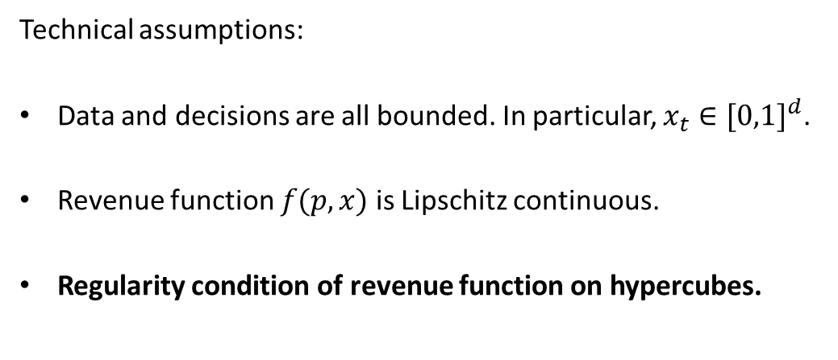



Model setup and assumptions
$$B_{1}$$
$$B_{2}$$
Technical assumptions:
Data and decisions are all bounded. In particular, $x_{t}∈{[0,1]}^{d}$.
Revenue function $f(p,x)$ is Lipschitz continuous.
Regularity condition of revenue function on hypercubes.
$$B_{3}$$
$$B_{4}$$
$$x_{t}$$
Space ${[0,1]}^{d}$ of data divided into hypercubes $B_{1},B_{2},…$

Slide 14
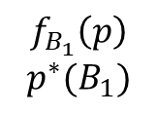
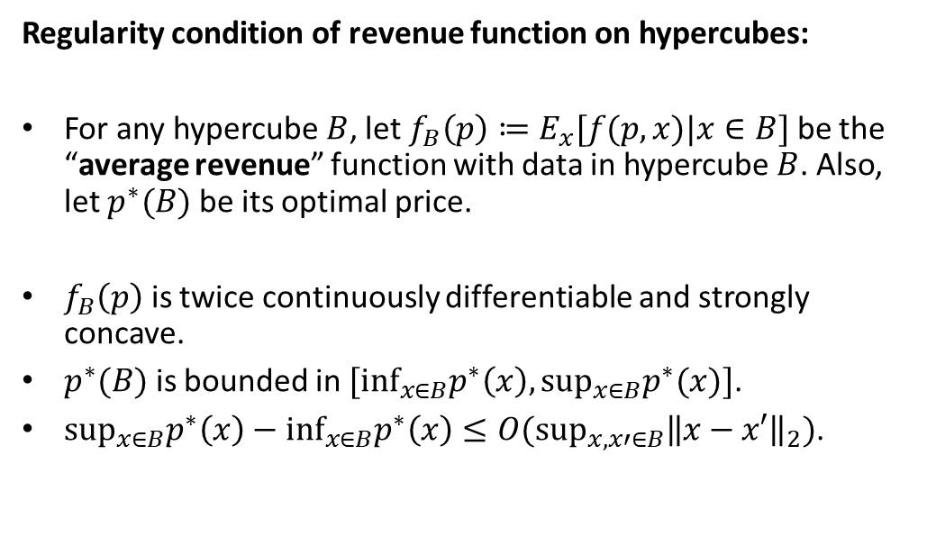
Model setup and assumptions
$$B_{1}$$
$$B_{2}$$
Regularity condition of revenue function on hypercubes:
For any hypercube $B$, let $f_{B}\left(p\right)≔E_{x}[f(p,x)|x∈B]$ be the “average revenue” function with data in hypercube $B$. Also, let $p^{∗}(B)$ be its optimal price.
$f_{B}\left(p\right)$ is twice continuously differentiable and strongly concave.
$p^{∗}(B)$ is bounded in $[\inf_{x∈B}p^{∗}\left(x\right),\sup_{x∈B}p^{∗}(x)]$.
${\sup_{x∈B}p^{∗}\left(x\right)−inf}_{x∈B}p^{∗}\left(x\right)≤O(\sup_{x,x′∈B}{\left\|x−x′\right\|}_{2})$.
$$f_{B_{1}}\left(p\right)$$
$$p^{∗}(B_{1})$$
$$B_{3}$$
$$B_{4}$$
$$x_{t}$$

Slide 15
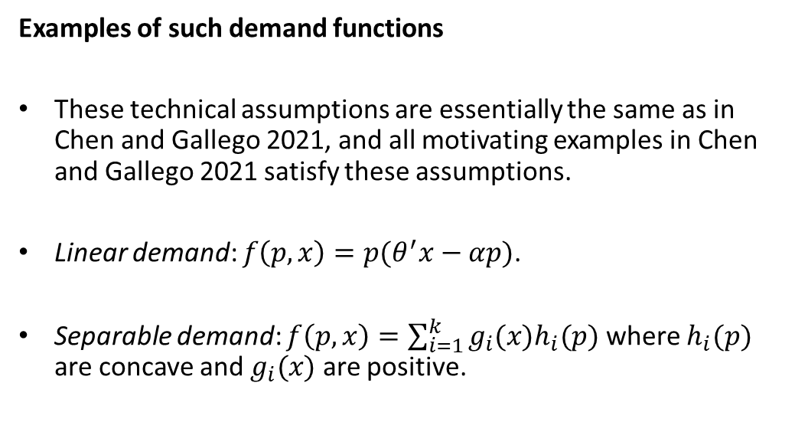
Model setup and assumptions
$$B_{1}$$
$$B_{2}$$
Examples of such demand functions
These technical assumptions are essentially the same as in Chen and Gallego 2021, and all motivating examples in Chen and Gallego 2021 satisfy these assumptions.
Linear demand: $f\left(p,x\right)=p(θ^{′}x−αp)$.
Separable demand: $f\left(p,x\right)=\sum_{i=1}^{k}{g_{i}(x)h_{i}(p)}$ where $h_{i}(p)$ are concave and $g_{i}(x)$ are positive.
$$f_{B_{1}}\left(p\right)$$
$$p^{∗}(B_{1})$$
$$B_{3}$$
$$B_{4}$$
$$x_{t}$$

Slide 16
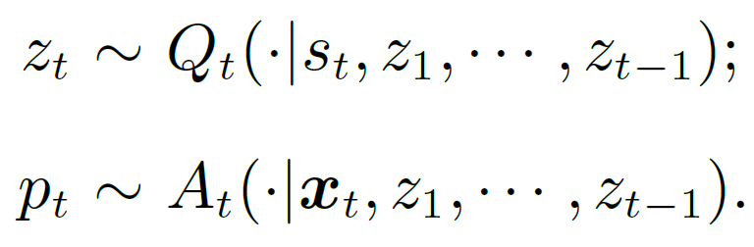
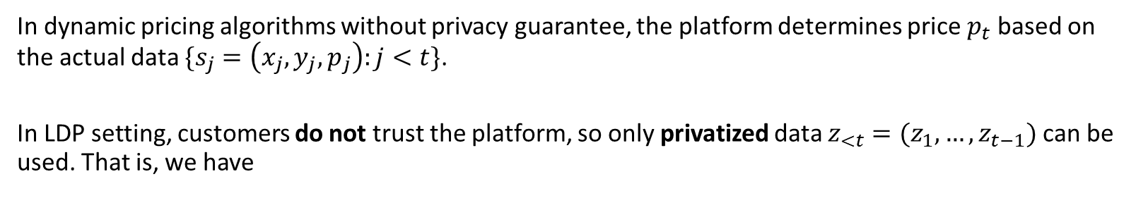
LDP in our setting: decision making based on privatized data
In dynamic pricing algorithms without privacy guarantee, the platform determines price $p_{t}$ based on the actual data $\{s_{j}=\left(x_{j},y_{j},p_{j}\right):j<t\}$.
In LDP setting, customers do not trust the platform, so only privatized data $z_{<t}=(z_{1},…,z_{t−1})$ can be used. That is, we have
Here $Q_{t}$ is a privatization mechanism, and $A_{t}$ is the pricing algorithm.

Slide 17
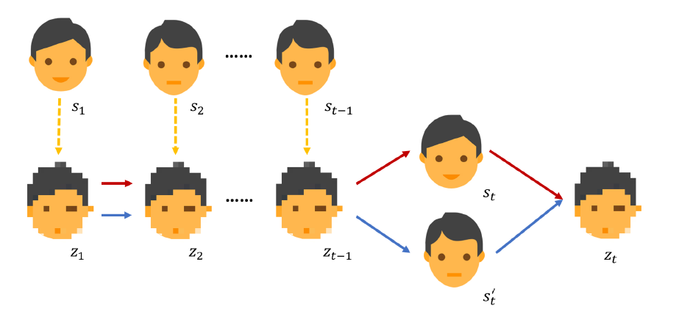
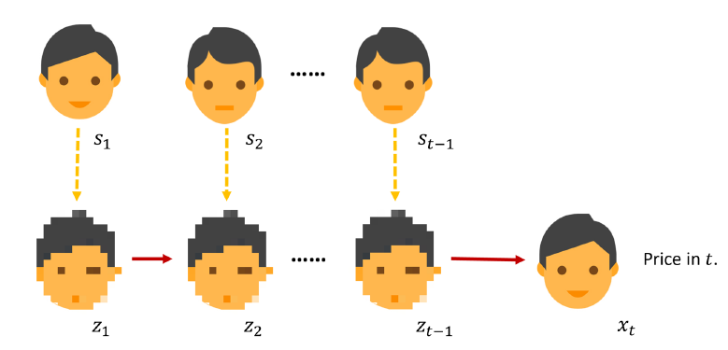
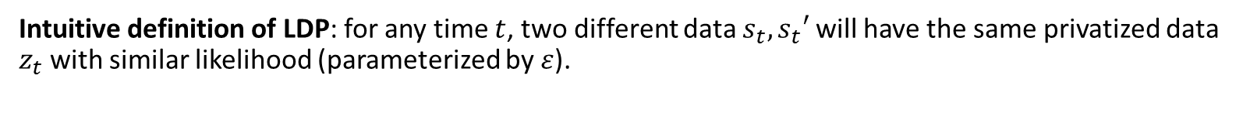


LDP in our setting: decision making based on privatized data
Intuitive definition of LDP: for any time $t$, two different data $s_{t},s_{t}′$ will have the same privatized data $z_{t}$with similar likelihood (parameterized by $ε$).
Privatization mechanism $Q_{t}$
Pricing policy $A_{t}$ with LDP guarantee

Slide 18
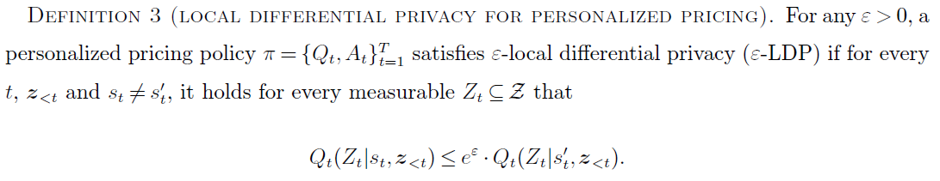
LDP in our setting: decision making based on privatized data
Privatization mechanism $Q_{t}$
Pricing policy $A_{t}$ with LDP guarantee

Slide 19
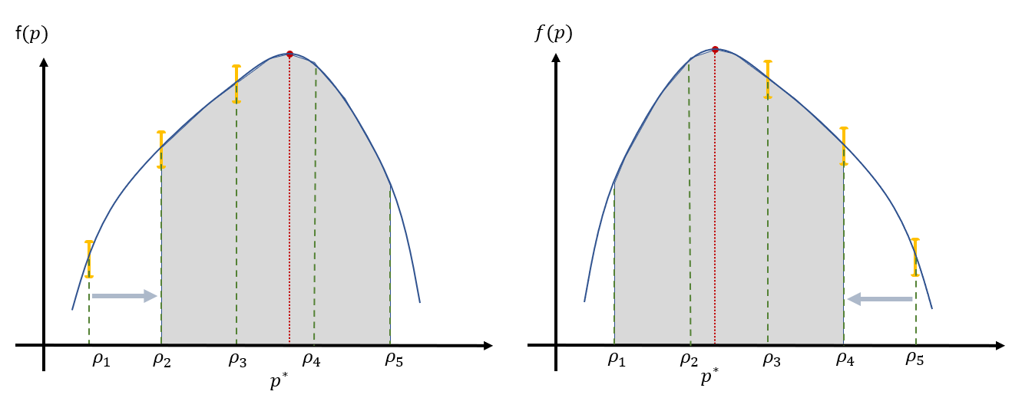
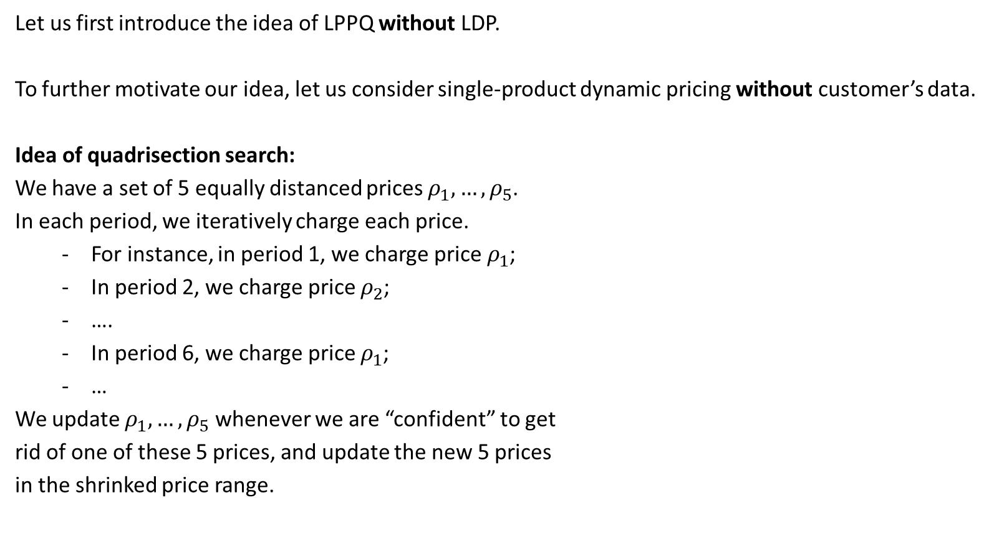
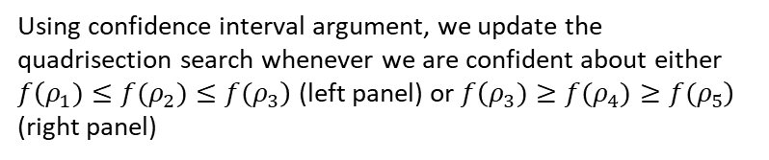
Our algorithm: the Locally-Private-Parallel-Quadrisection (LPPQ)
Let us first introduce the idea of LPPQ without LDP.
To further motivate our idea, let us consider single-product dynamic pricing without customer’s data.
Idea of quadrisection search:
We have a set of 5 equally distanced prices $ρ_{1},…,ρ_{5}$.
In each period, we iteratively charge each price.
  For instance, in period 1, we charge price $ρ_{1}$;
  In period 2, we charge price $ρ_{2}$;
  ….
  In period 6, we charge price $ρ_{1}$;
  …
We update $ρ_{1},…,ρ_{5}$ whenever we are “confident” to get
rid of one of these 5 prices, and update the new 5 prices
in the shrinked price range.
Using confidence interval argument, we update the quadrisection search whenever we are confident about either $f\left(ρ_{1})≤f(ρ_{2})≤{f(ρ}_{3}\right)$ (left panel) or $f\left(ρ_{3}){≥f(ρ}_{4}){≥f(ρ}_{5}\right)$ (right panel)

Slide 20
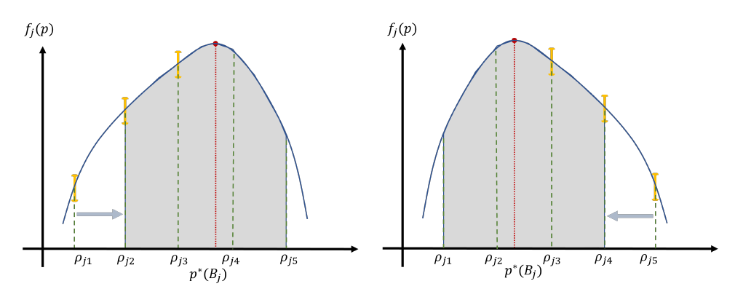


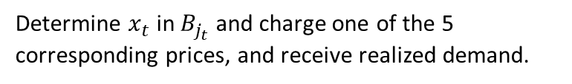
Our algorithm: the Locally-Private-Parallel-Quadrisection (LPPQ)
Let us first introduce the idea of LPPQ without LDP.
$$B_{j}, j=1,…,J$$
Determine $x_{t}$ in $B_{j_{t}}$ and charge one of the 5 corresponding prices, and receive realized demand.
$$x_{t}$$
Do quadrisection search update for all hypercubes $B_{j}$.

Slide 21
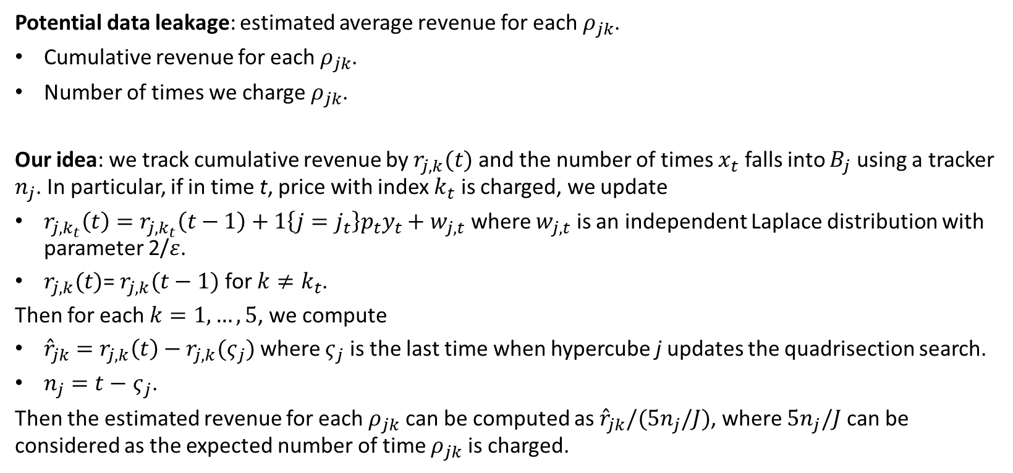
Our algorithm: the Locally-Private-Parallel-Quadrisection (LPPQ)
Potential data leakage: estimated average revenue for each $ρ_{jk}$.
Cumulative revenue for each $ρ_{jk}$.
Number of times we charge $ρ_{jk}$.
Our idea: we track cumulative revenue by $r_{j,k}(t)$ and the number of times $x_{t}$ falls into $B_{j}$ using a tracker $n_{j}$. In particular, if in time t, price with index $k_{t}$ is charged, we update
$r_{j,k_{t}}\left(t\right)=r_{j,k_{t}}\left(t−1\right)+1\left\{j=j_{t}\right\}p_{t}y_{t}+w_{j,t}$ where $w_{j,t}$ is an independent Laplace distribution with parameter 2/$ε$.
$r_{j,k}(t)$= $r_{j,k}(t−1)$ for $k≠k_{t}$.
Then for each $k=1,…,5$, we compute
${\hat{r}}_{jk}=$ $r_{j,k}\left(t\right)−r_{j,k}(ς_{j})$ where $ς_{j}$ is the last time when hypercube j updates the quadrisection search.
$n_{j}=t−$ $ς_{j}$.
Then the estimated revenue for each $ρ_{jk}$ can be computed as ${\hat{r}}_{jk}/(5n_{j}/J)$, where $5n_{j}/J$ can be considered as the expected number of time $ρ_{jk}$ is charged.

Slide 22
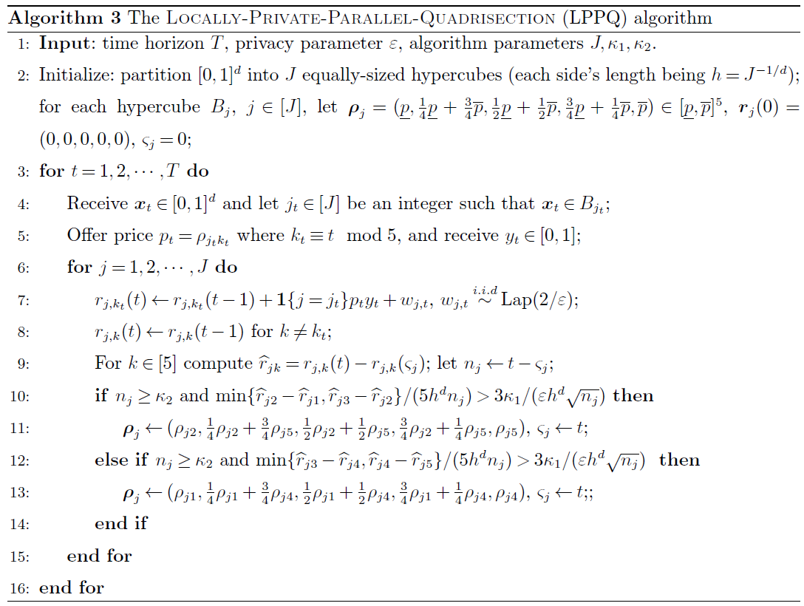
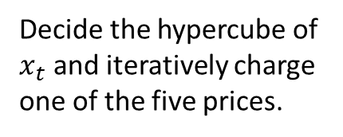
Our algorithm: the Locally-Private-Parallel-Quadrisection (LPPQ)
Decide the hypercube of $x_{t}$ and iteratively charge one of the five prices.

Slide 23
Our algorithm: the Locally-Private-Parallel-Quadrisection (LPPQ)
Privatize sensitive data.

Slide 24
Our algorithm: the Locally-Private-Parallel-Quadrisection (LPPQ)
Quadrisection search update for each hypercube using privatized data based on confidence interval argument.

Slide 25
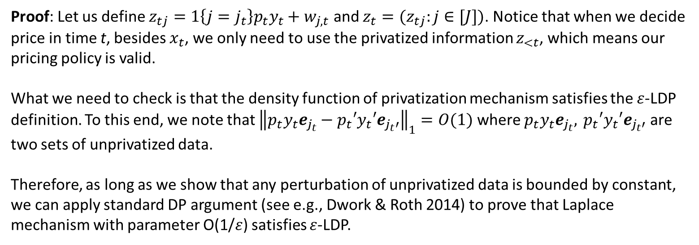

Proposition: our algorithm LPPQ is $ε$-LDP
Proof: Let us define $z_{tj}=1\left\{j=j_{t}\right\}p_{t}y_{t}+w_{j,t}$ and $z_{t}=(z_{tj}:j∈[J])$. Notice that when we decide price in time t, besides $x_{t}$, we only need to use the privatized information $z_{<t}$, which means our pricing policy is valid.
What we need to check is that the density function of privatization mechanism satisfies the $ε$-LDP definition. To this end, we note that ${\left\|p_{t}y_{t}e_{j_{t}}−p_{t}′y_{t}′e_{j_{t}′}\right\|}_{1}=O(1)$ where $p_{t}y_{t}e_{j_{t}}, { p}_{t}′y_{t}′e_{j_{t}′}$ are two sets of unprivatized data.
Therefore, as long as we show that any perturbation of unprivatized data is bounded by constant, we can apply standard DP argument (see e.g., Dwork & Roth 2014) to prove that Laplace mechanism with parameter O(1/$ε$) satisfies $ε$-LDP.

Slide 26
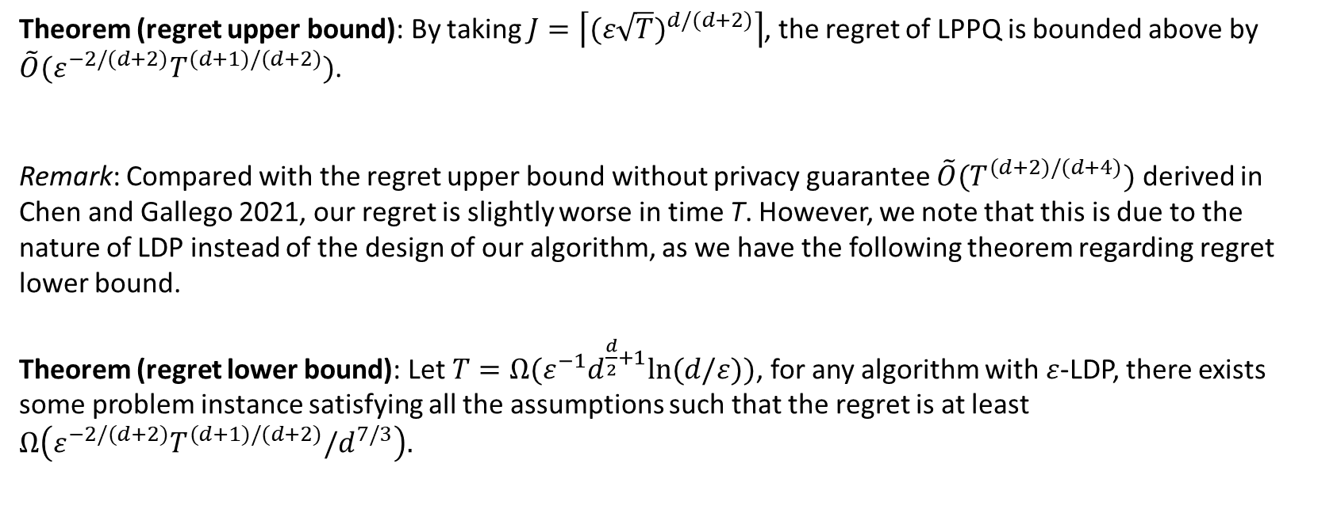
LPPQ achieves near-optimal regret
Theorem (regret upper bound): By taking $J=\left\lceil (ε\sqrt{T})^{d/(d+2)}\right\rceil$, the regret of LPPQ is bounded above by $\tilde{O}(ε^{−2/(d+2)}T^{(d+1)/(d+2)})$.
Remark: Compared with the regret upper bound without privacy guarantee $\tilde{O}(T^{(d+2)/(d+4)})$ derived in Chen and Gallego 2021, our regret is slightly worse in time T. However, we note that this is due to the nature of LDP instead of the design of our algorithm, as we have the following theorem regarding regret lower bound.
Theorem (regret lower bound): Let $T=Ω(ε^{−1}d^{\frac{d}{2}+1}ln⁡(d/ε))$, for any algorithm with $ε$-LDP, there exists some problem instance satisfying all the assumptions such that the regret is at least $Ω\left(ε^{−2/(d+2)}T^{(d+1)/(d+2)}/d^{7/3}\right).$

Slide 27
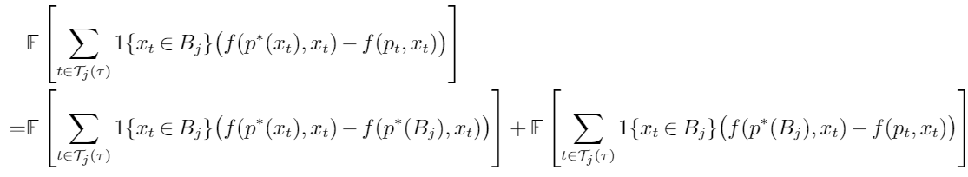
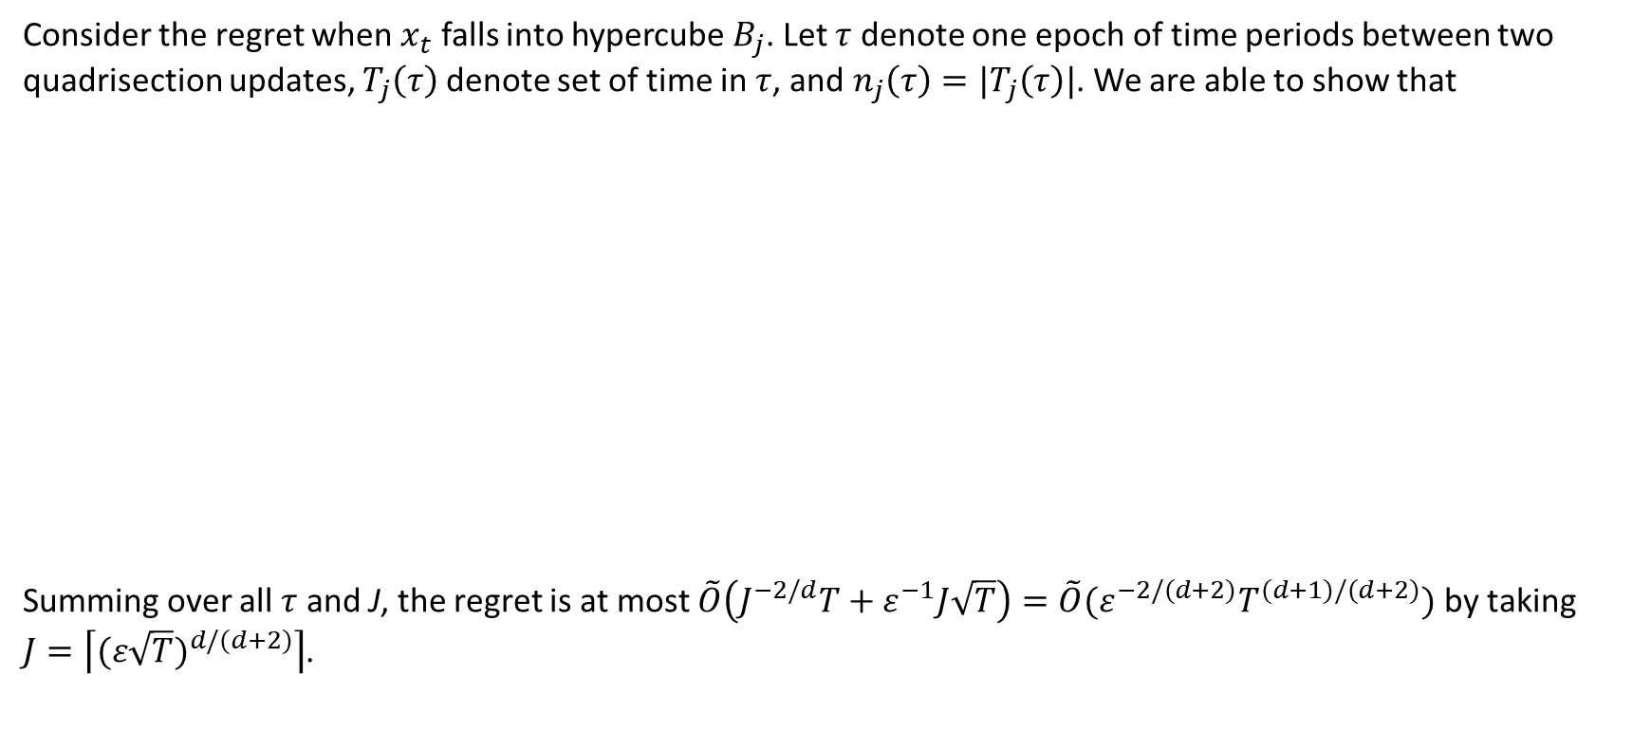
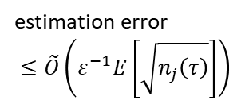

Idea of proving regret upper bound
Consider the regret when $x_{t}$ falls into hypercube $B_{j}$. Let $τ$ denote one epoch of time periods between two quadrisection updates, $T_{j}\left(τ\right)$ denote set of time in $τ$, and $n_{j}\left(τ\right)=|T_{j}\left(τ\right)|$. We are able to show that
Summing over all $τ$ and J, the regret is at most $\tilde{O}\left(J^{−2/d}T+ε^{−1}J\sqrt{T}\right)=\tilde{O}(ε^{−2/(d+2)}T^{(d+1)/(d+2)})$ by taking
$J=\left\lceil (ε\sqrt{T})^{d/(d+2)}\right\rceil$.
approximation error
$≤\tilde{O}\left(J^{−(d+2)/d}E\left[n_{j}\left(τ\right)\right]\right)$
estimation error
$$≤\tilde{O}\left(ε^{−1}E\left[\sqrt{n_{j}\left(τ\right)}\right]\right)$$

Slide 28
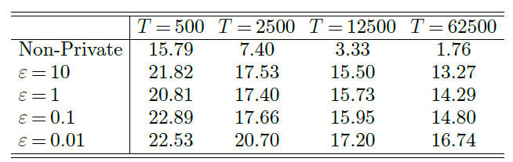
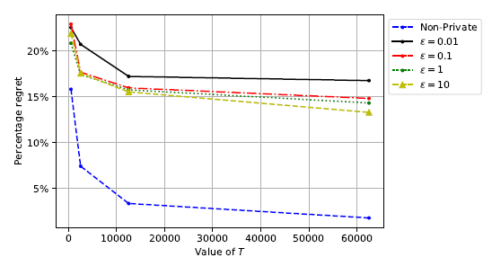
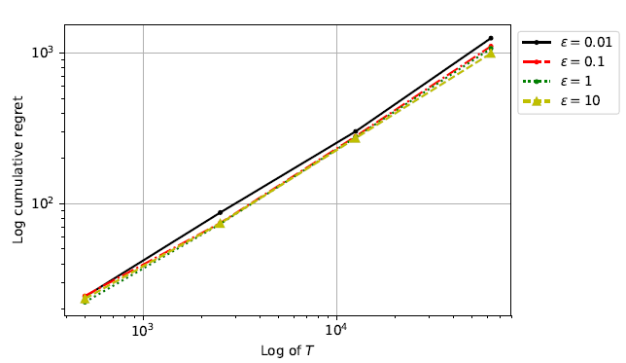

Numerical Experiments
For illustration, we test linear demand $λ\left(p,x\right)=θ_{0}+θ_{1}x_{1}+θ_{2}x_{2}+θ_{3}p$ where $θ=(0.4,0.6,0.6,−0.2)$ and demand error is uniform in [-0.1,0.1].
The slope is around $0.75=\frac{d+1}{d+2}.$

Slide 29
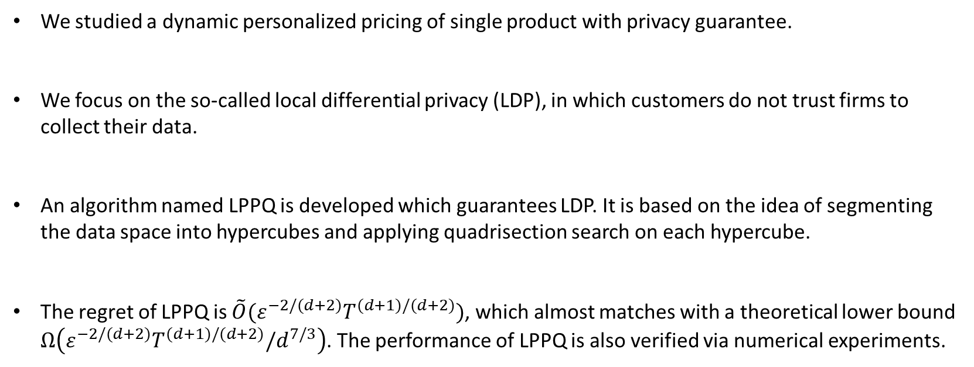
Summary of today’s talk
We studied a dynamic personalized pricing of single product with privacy guarantee.
We focus on the so-called local differential privacy (LDP), in which customers do not trust firms to collect their data.
An algorithm named LPPQ is developed which guarantees LDP. It is based on the idea of segmenting the data space into hypercubes and applying quadrisection search on each hypercube.
The regret of LPPQ is $\tilde{O}(ε^{−2/(d+2)}T^{(d+1)/(d+2)})$, which almost matches with a theoretical lower bound $Ω\left(ε^{−2/(d+2)}T^{(d+1)/(d+2)}/d^{7/3}\right)$. The performance of LPPQ is also verified via numerical experiments.

Slide 30
Thank you!
Comments and questions?
Email: yining.wang@utdallas.edu

