Slide 1
Robust Dynamic Assortment Planning in the Presence of Outliers
Xi Chen, Stern School of Business, New York University
Akshay Krishnamurthy, Microsoft Research NYC
Yining Wang, Warrington College of Business, University of Florida

Slide 2
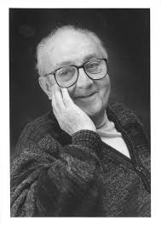
Model Mis-specification and Robust Statistics
Most operations problems are built on probabilistic models
  Pricing assumes an underlying demand model
  Assortment optimization assumes an underlying choice model
George E. P. Box: “all models are wrong, but some are useful”
Deal with model mis-specification and robustness in online learning for operations
  Dynamic assortment optimization

Slide 3

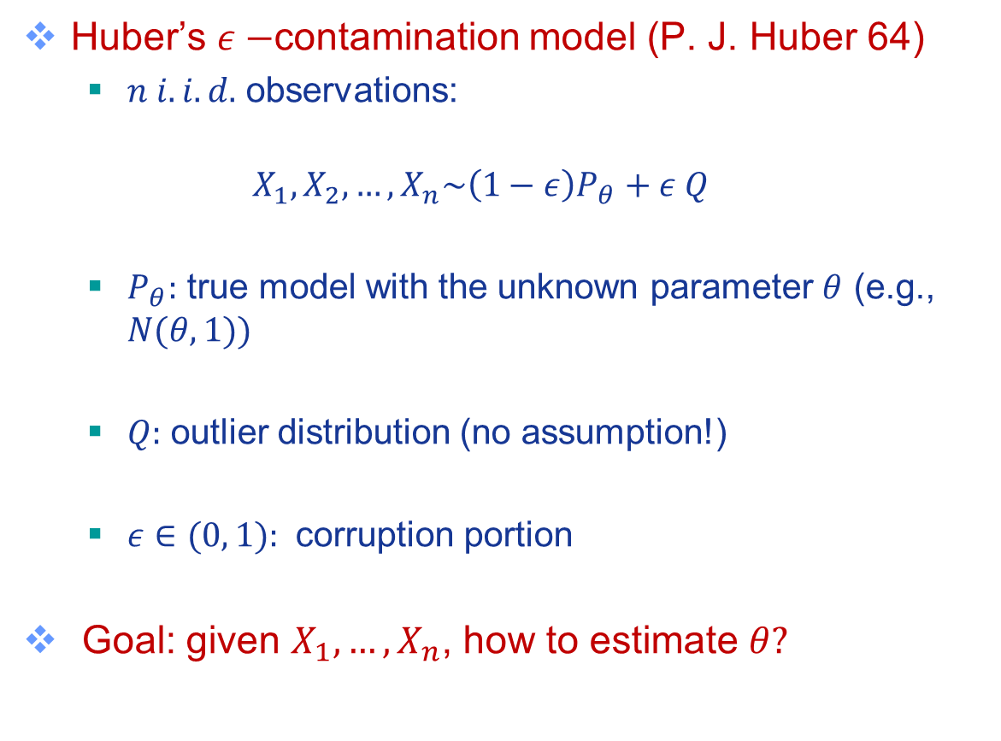
Model Mis-specification and Robust Statistics
Huber’s $ε−$contamination model (P. J. Huber 64)
  $n i.i.d.$ observations:
  $${ X}_{1},X_{2},…,X_{n}\sim \left(1−ε\right)P_{θ}+ε Q$$
  $P_{θ}:$ true model with the unknown parameter $θ$ (e.g., $N(θ,1))$
  $Q:$ outlier distribution (no assumption!)
  $ε∈(0, 1):$ corruption portion
Goal: given $X_{1},…, X_{n}$, how to estimate $θ?$

Slide 4
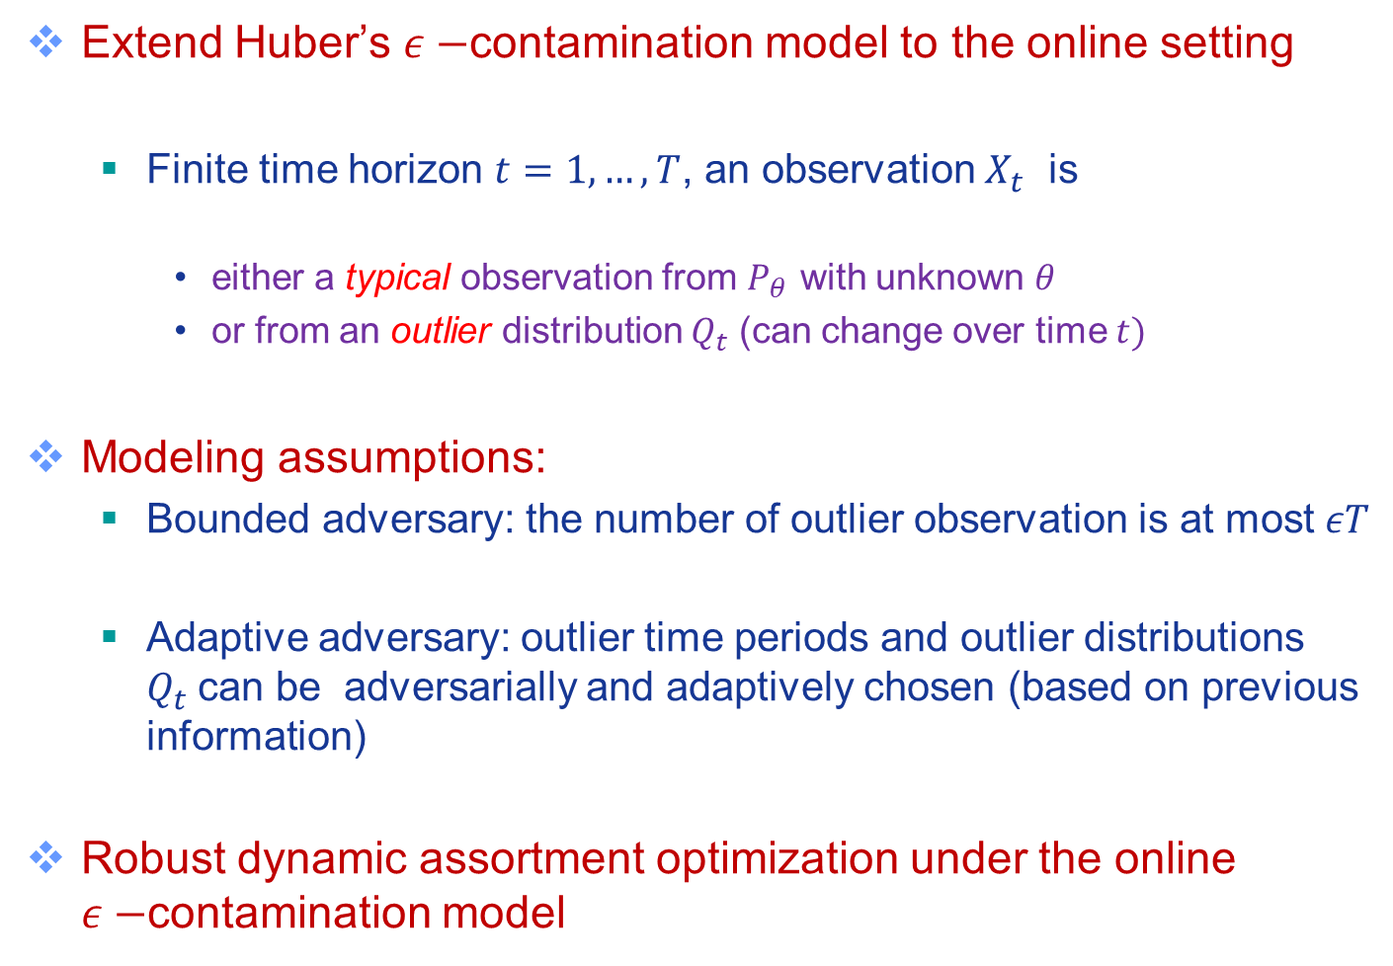
Model Mis-specification and Robust Statistics
Extend Huber’s $ε−$contamination model to the online setting
  Finite time horizon $t=1,…, T$, an observation $X_{t}$ is
    either a typical observation from $P_{θ}$ with unknown $θ$
    or from an outlier distribution $Q_{t}$ (can change over time $t)$
Modeling assumptions:
  Bounded adversary: the number of outlier observation is at most $εT$
  Adaptive adversary: outlier time periods and outlier distributions $Q_{t}$can be adversarially and adaptively chosen (based on previous information)
Robust dynamic assortment optimization under the online $ε−$contamination model

Slide 5

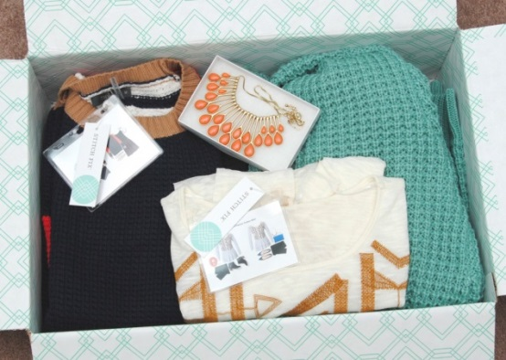
Assortment Optimization
Goal: select a subset of items among substitutable items to maximize expected revenue
  Online Retailing

Slide 6

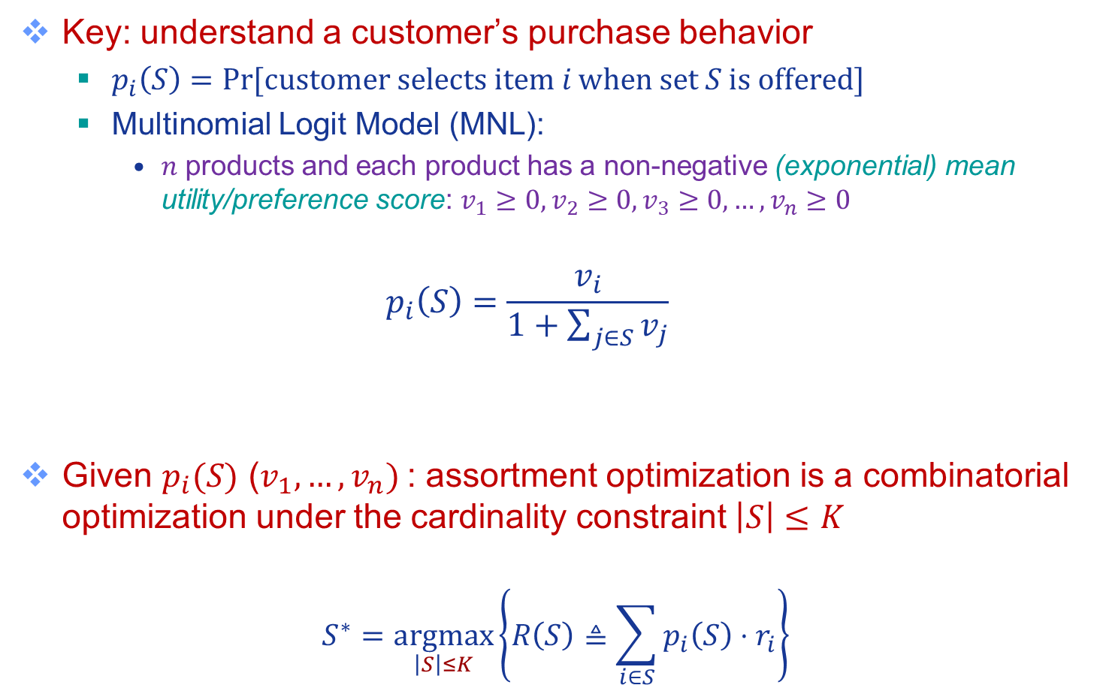

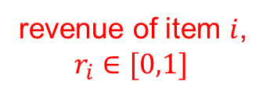
Stationary problem
Key: understand a customer’s purchase behavior
  $p_{i}\left(S\right)=\operatorname{Pr}{[\text{customer} \text{selects} \text{item} i \text{when} \text{set} S \text{is} \text{offered}]}$
  Multinomial Logit Model (MNL):
    $n$ products and each product has a non-negative (exponential) mean utility/preference score: $v_{1}≥0,v_{2}≥0,v_{3}≥0,…, v_{n}≥0$
  $$p_{i}\left(S\right)=\frac{v_{i}}{1+\sum_{j∈S}{v_{j}}}$$
Given $p_{i}(S)$ ($v_{1},…,v_{n})$: assortment optimization is a combinatorial optimization under the cardinality constraint $\left|S\right|≤K$
$$S^{∗}=\underset{\left|S\right|≤K}{argmax}\left\{R\left(S\right)≜\sum_{i∈S}{p_{i}\left(S\right)⋅r_{i}}\right\}$$
“no-purchase” ($v_{0}=1)$
Expected revenue when offering set$S$
revenue of item $i$,
$$r_{i}∈[0,1]$$

Slide 7

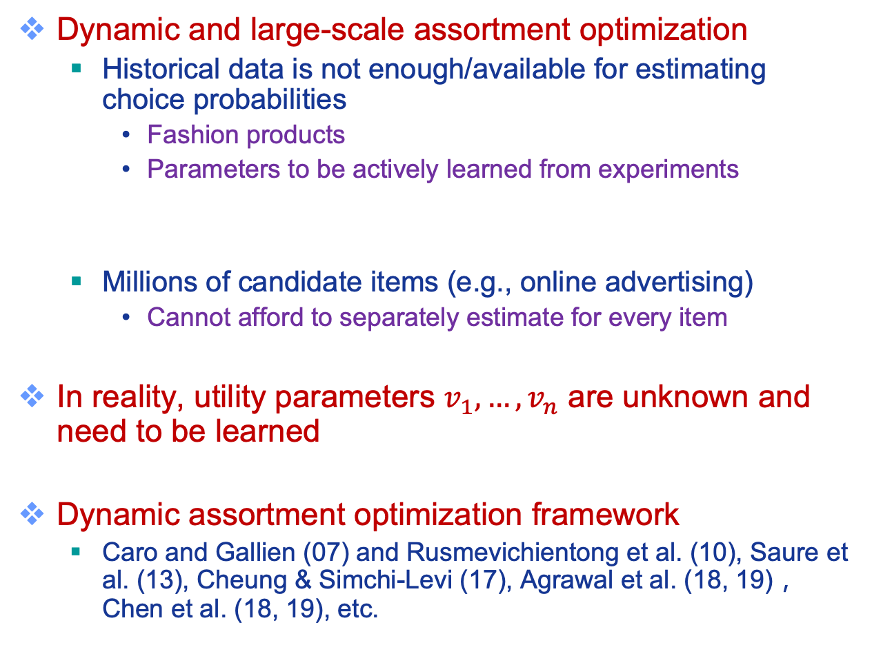
Dynamic and Large-scale Challenges
Dynamic and large-scale assortment optimization
  Historical data is not enough/available for estimating choice probabilities
    Fashion products
    Parameters to be actively learned from experiments
  Millions of candidate items (e.g., online advertising)
    Cannot afford to separately estimate for every item
In reality, utility parameters $v_{1},…,v_{n}$ are unknown and need to be learned
Dynamic assortment optimization framework
  Caro and Gallien (07) and Rusmevichientong et al. (10), Saure et al. (13), Cheung & Simchi-Levi (17), Agrawal et al. (18, 19)，Chen et al. (18, 19), etc.

Slide 8



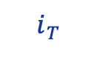
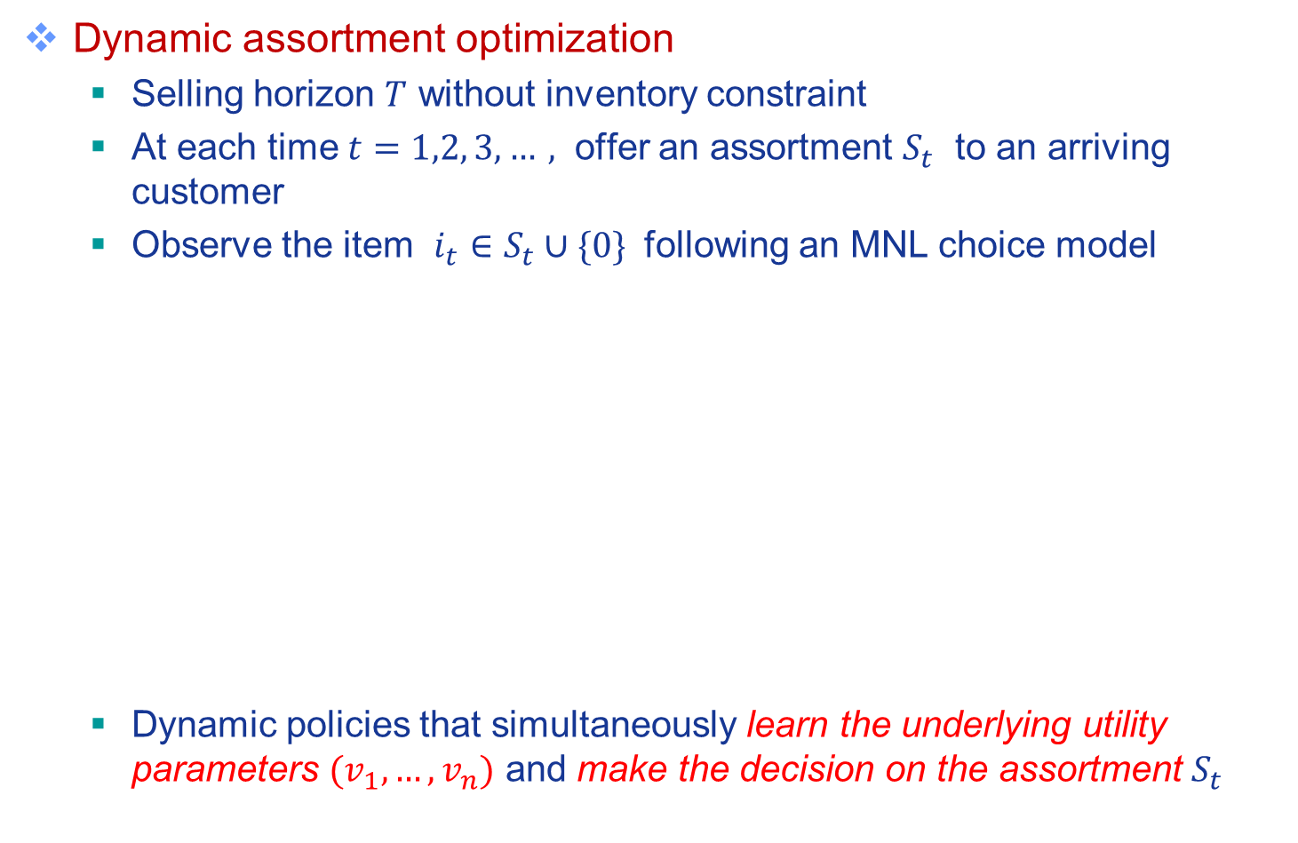

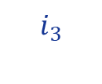
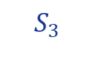



Dynamic Assortment Planning
Dynamic assortment optimization
  Selling horizon $T$ without inventory constraint
  At each time $t=1,2, 3, …,$ offer an assortment $S_{t}$ to an arriving customer
  Observe the item $i_{t}∈S_{t}∪\{0\}$ following an MNL choice model
  Dynamic policies that simultaneously learn the underlying utility parameters $(v_{1},…, v_{n})$ and make the decision on the assortment $S_{t}$
$$S_{1}$$
$$S_{2}^{}$$
$$S_{3}$$
$$S_{T}$$
$$i_{1}^{}$$
$$i_{2}$$
$$i_{3}$$
$$i_{T}$$

Slide 9

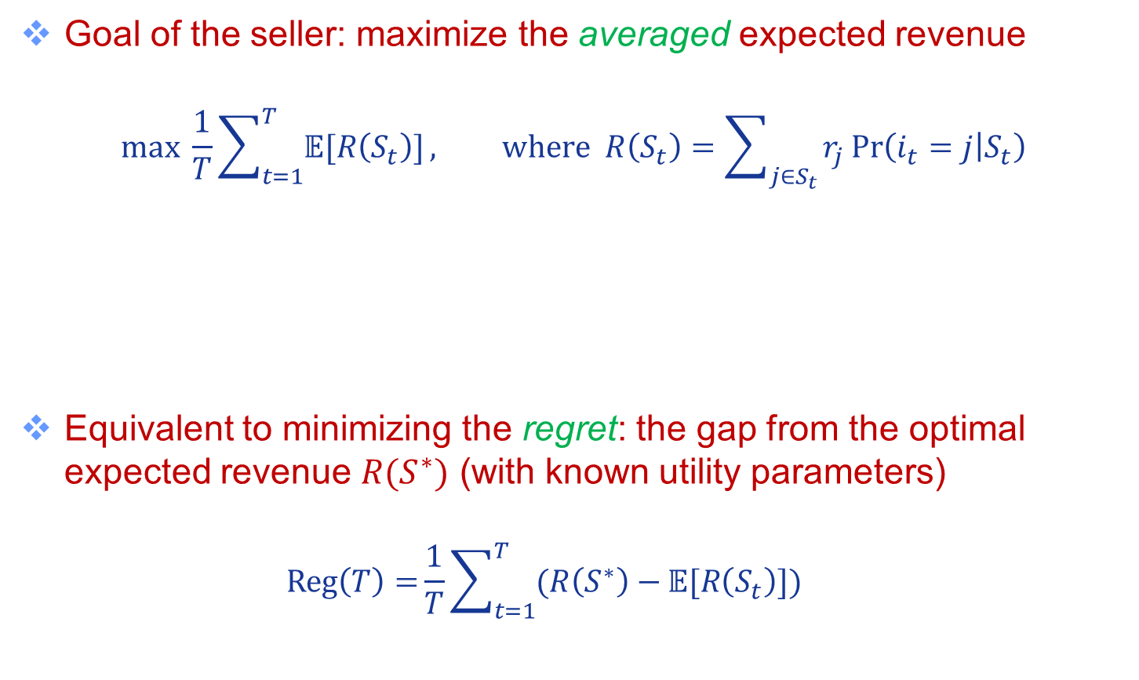
Regret Analysis Framework
Goal of the seller: maximize the averaged expected revenue
$$\max{ \frac{1}{T}\sum_{t=1}^{T}{𝔼[R\left(S_{t}\right)]}}, where R\left(S_{t}\right)=\sum_{j∈S_{t}}{r_{j}}\operatorname{Pr}\left(i_{t}=j | S_{t}\right)$$
Equivalent to minimizing the regret: the gap from the optimal expected revenue $R(S^{∗})$ (with known utility parameters)
  $$Reg\left(T\right)={\frac{1}{T}\sum_{t=1}^{T}{(R\left(S^{∗}\right)−}}𝔼[R\left(S_{t}\right)])$$
Expected revenue when offering $S_{t}$ at time $t$

Slide 10
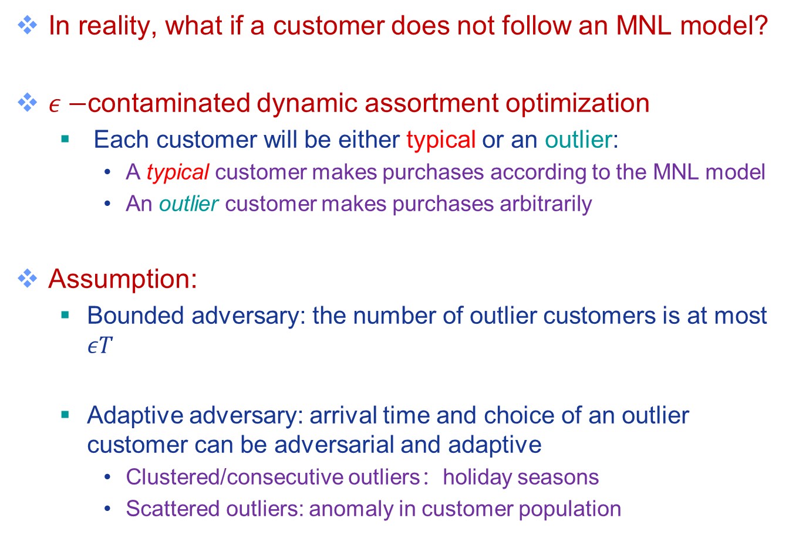
Robust Dynamic Assortment Planning
In reality, what if a customer does not follow an MNL model?
$ε−$contaminated dynamic assortment optimization
  Each customer will be either typical or an outlier:
    A typical customer makes purchases according to the MNL model
    An outlier customer makes purchases arbitrarily
Assumption:
  Bounded adversary: the number of outlier customers is at most $εT$
  Adaptive adversary: arrival time and choice of an outlier customer can be adversarial and adaptive
    Clustered/consecutive outliers：holiday seasons
    Scattered outliers: anomaly in customer population

Slide 11
Technical Challenges
Challenge 1: clustered outlier customers
  parameter estimation significantly skewed by clustered/consecutive outlier customers
  UCB will not work
  Solution: active elimination scheme with enlarged confidence intervals
Challenge 2: inadequacy of epoch-based exploration
  Background: existing method (Agrawal et al. 10) uses “epoch-based explorations” to construct unbiased estimate of utilities:
    offering the same assortment repetitively until no purchase
  Outliers significantly impact the epoch stopping time (no-purchase)
  Solution: use fixed-length epochs with doubling trick and carefully bound biased estimates

Slide 12
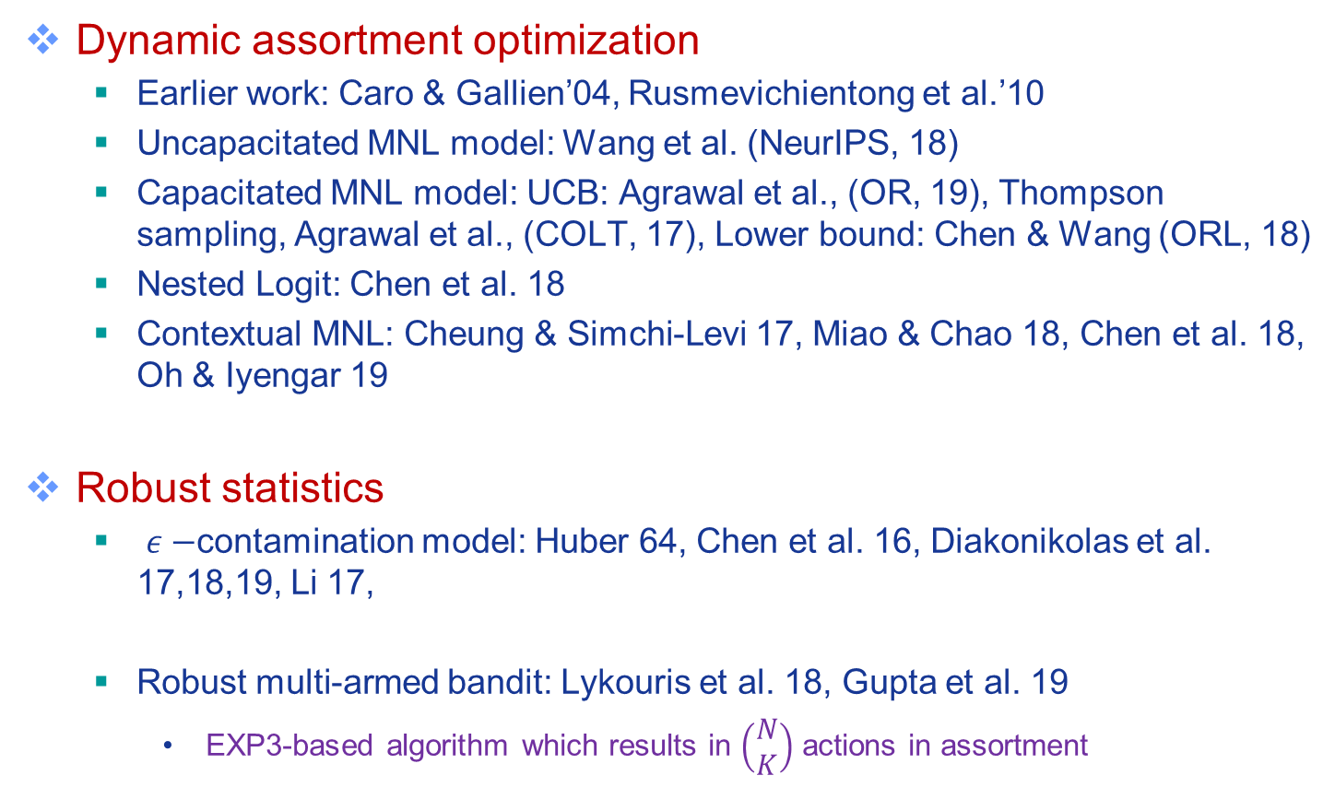
Related Work
Dynamic assortment optimization
  Earlier work: Caro & Gallien’04, Rusmevichientong et al.’10
  Uncapacitated MNL model: Wang et al. (NeurIPS, 18)
  Capacitated MNL model: UCB: Agrawal et al., (OR, 19), Thompson sampling, Agrawal et al., (COLT, 17), Lower bound: Chen & Wang (ORL, 18)
  Nested Logit: Chen et al. 18
  Contextual MNL: Cheung & Simchi-Levi 17, Miao & Chao 18, Chen et al. 18, Oh & Iyengar 19
Robust statistics
  $ε−$contamination model: Huber 64, Chen et al. 16, Diakonikolas et al. 17,18,19, Li 17,
  Robust multi-armed bandit: Lykouris et al. 18, Gupta et al. 19
    EXP3-based algorithm which results in $\left(\begin{matrix}N \\ K\end{matrix}\right)$ actions in assortment

Slide 13
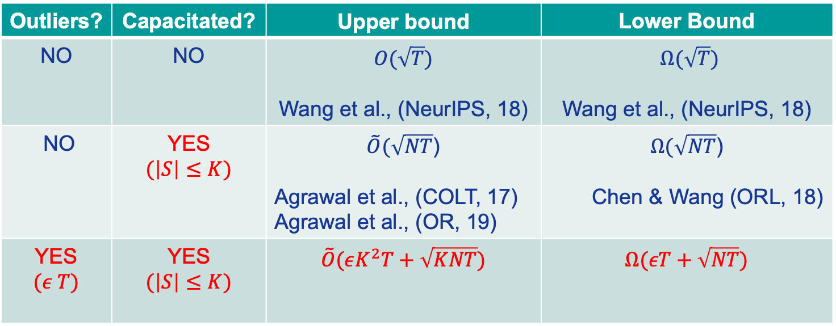
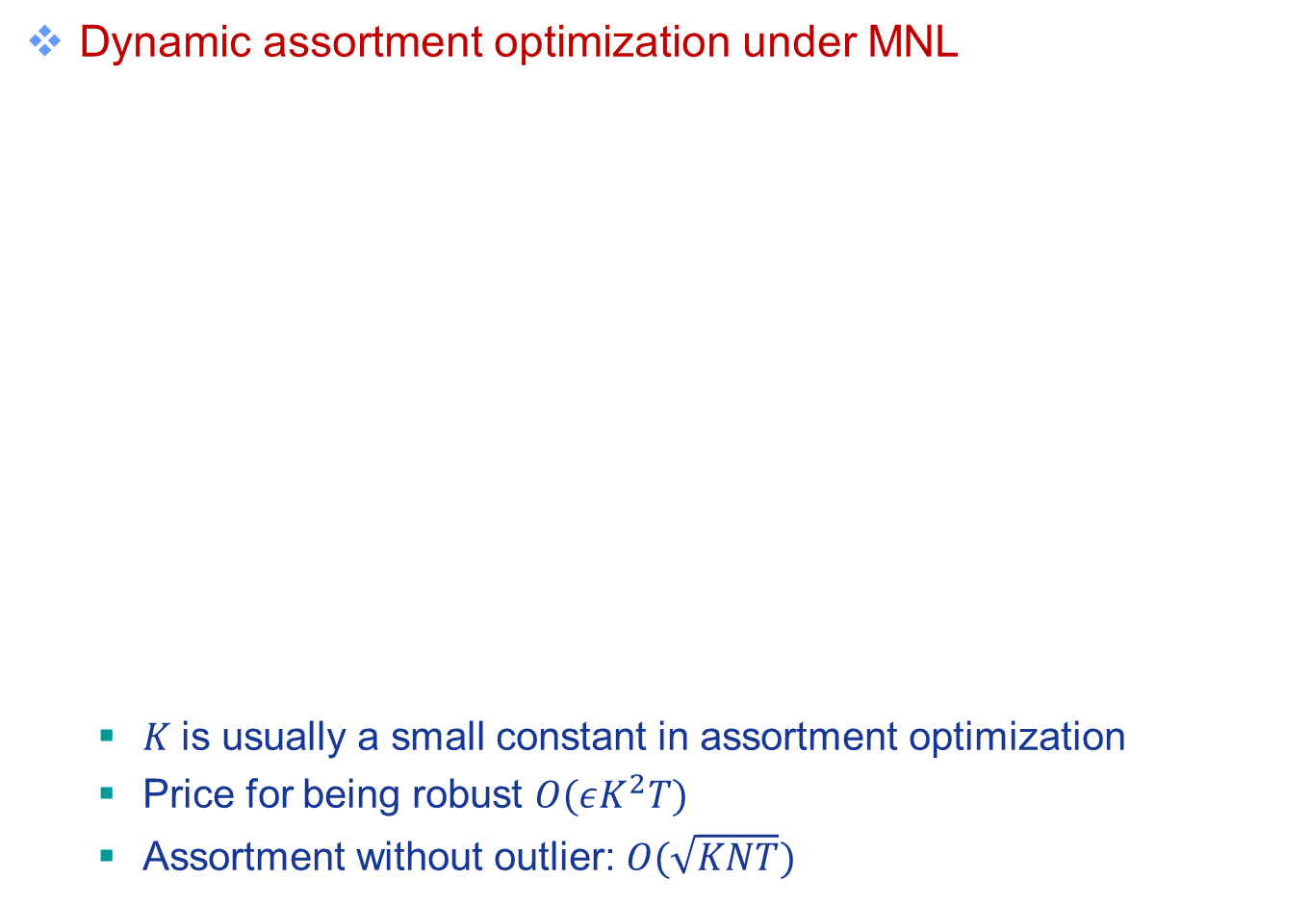
Main Result and Regret Comparison
Dynamic assortment optimization under MNL
  $K$is usually a small constant in assortment optimization
  Price for being robust $O(εK^{2}T)$
  Assortment without outlier: $O(\sqrt{KNT})$
Outliers? | Capacitated? | Upper bound | Lower Bound
NO | NO | $$O(\sqrt{T})$$ Wang et al., (NeurIPS, 18) | $Ω(\sqrt{T})$ Wang et al., (NeurIPS, 18)
NO | YES $$(\left|S\right|≤K)$$ | $\tilde{O}(\sqrt{NT}$) Agrawal et al., (COLT, 17) Agrawal et al., (OR, 19) | $Ω(\sqrt{NT}$) Chen & Wang (ORL, 18)
YES $$(ε T)$$ | YES $$(\left|S\right|≤K)$$ | $$\tilde{O}(εK^{2}T+\sqrt{KNT})$$ | $$Ω(εT+\sqrt{NT})$$

Slide 14


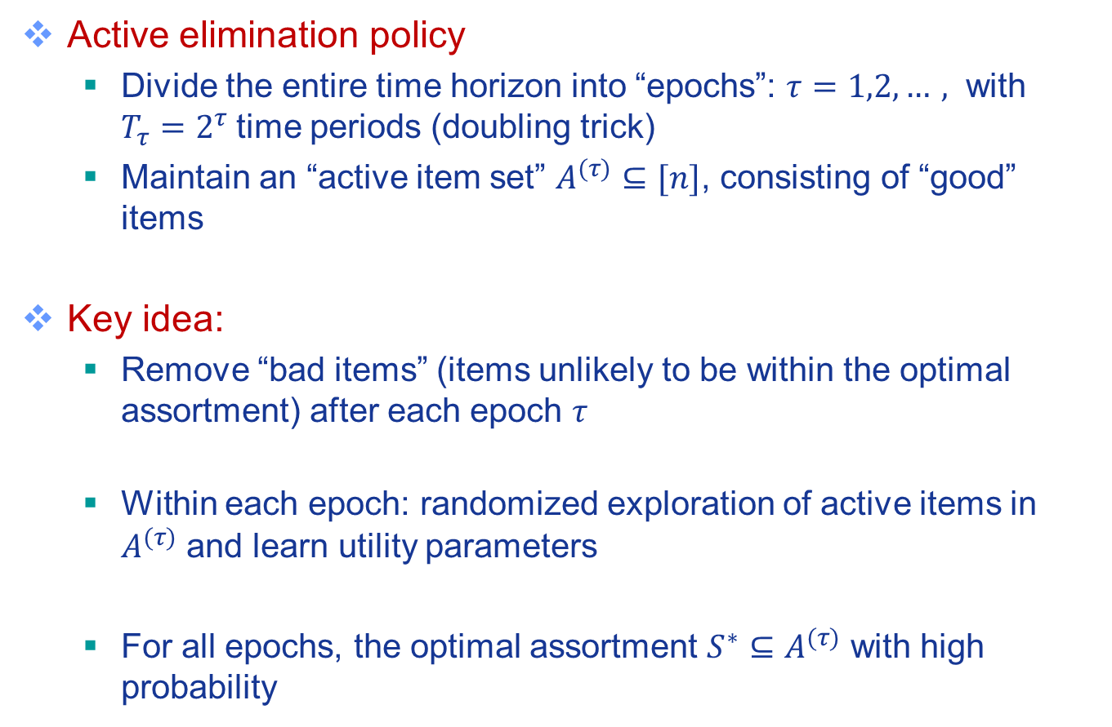
Active Elimination Policy
Active elimination policy
  Divide the entire time horizon into “epochs”: $τ=1,2,…,$ with $T_{τ}=2^{τ}$time periods (doubling trick)
  Maintain an “active item set” $A^{(τ)}⊆[n]$, consisting of “good” items
Key idea:
  Remove “bad items” (items unlikely to be within the optimal assortment) after each epoch $τ$
  Within each epoch: randomized exploration of active items in $A^{(τ)}$ and learn utility parameters
  For all epochs, the optimal assortment $S^{∗}⊆A^{(τ)}$ with high probability

Slide 15
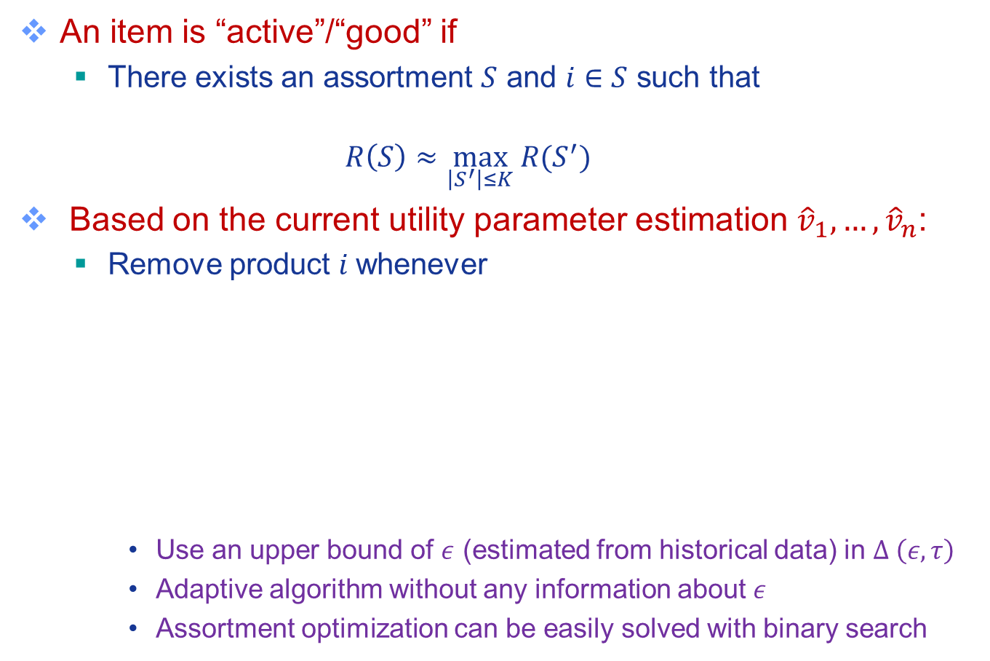
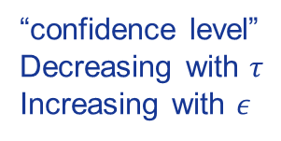
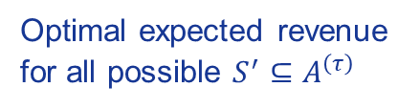
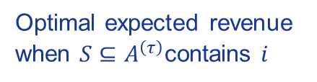
Step 1: How to Remove “Bad” Items?
An item is “active”/“good” if
  There exists an assortment $S$ and $i∈S$ such that
  $$R\left(S\right)≈\max_{\left|S^{′}\right|≤K} R(S^{′})$$
Based on the current utility parameter estimation ${\hat{v}}_{1},…, {\hat{v}}_{n}$:
  Remove product $i$whenever
    Use an upper bound of $ε$ (estimated from historical data) in $Δ \left(ε,τ\right)$
    Adaptive algorithm without any information about $ε$
    Assortment optimization can be easily solved with binary search
Optimal expected revenue
when $S⊆A^{\left(τ\right)}$contains $i$
Optimal expected revenue
for all possible $S^{′}⊆A^{\left(τ\right)}$
“confidence level”
Decreasing with $τ$
Increasing with $ε$

Slide 16
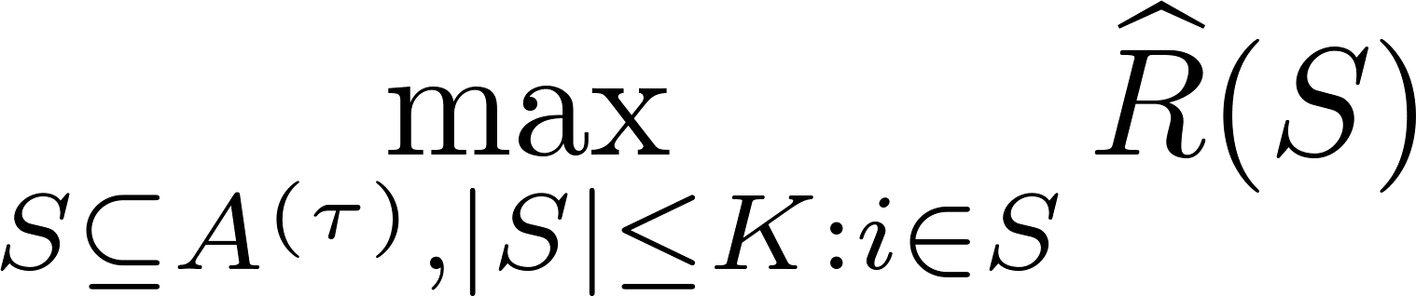
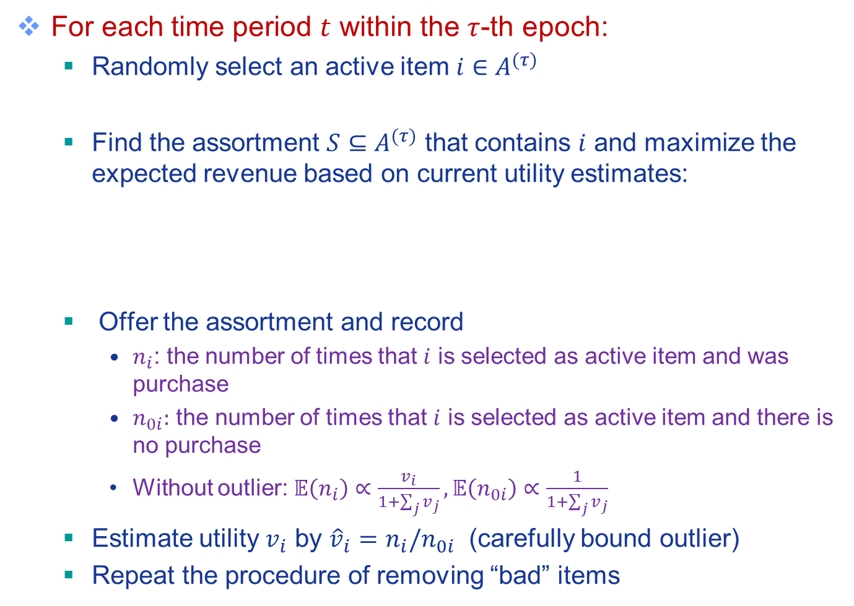
Step 2: Utility Estimation
For each time period $t$ within the $τ$-th epoch:
  Randomly select an active item $i∈A^{(τ)}$
  Find the assortment $S⊆A^{(τ)}$ that contains $i$ and maximize the expected revenue based on current utility estimates:
  Offer the assortment and record
    $n_{i}$: the number of times that $i$ is selected as active item and was purchase
    $n_{0i}:$ the number of times that $i$ is selected as active item and there is no purchase
    Without outlier: $𝔼\left(n_{i}\right)∝\frac{v_{i}}{1+\sum_{j}{v_{j}}},𝔼\left(n_{0i}\right)∝\frac{1}{1+\sum_{j}{v_{j}}}$
  Estimate utility $v_{i}$ by ${\hat{v}}_{i}=n_{i}/n_{0i}$ (carefully bound outlier)
  Repeat the procedure of removing “bad” items

Slide 17
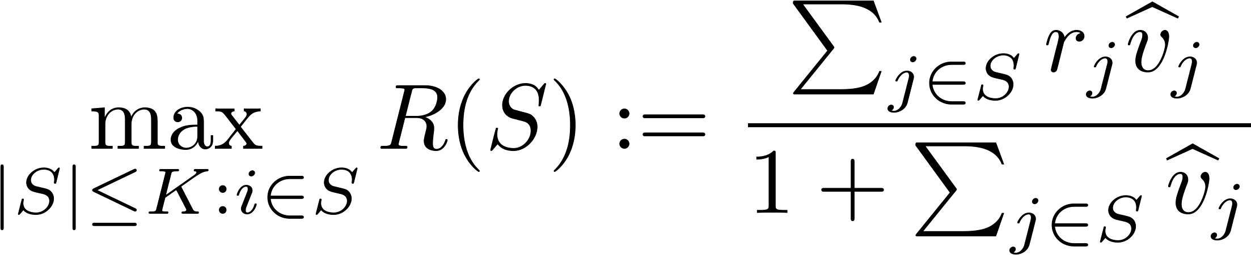
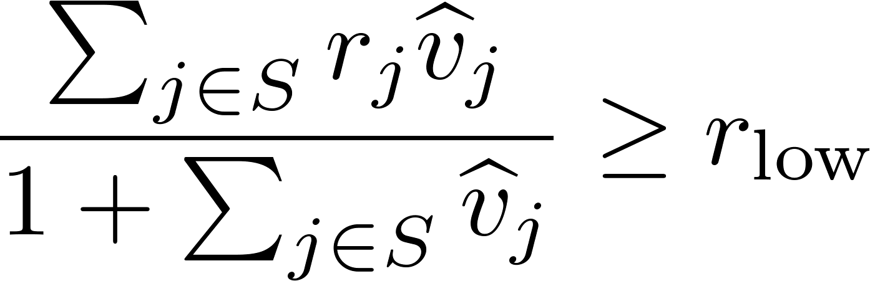
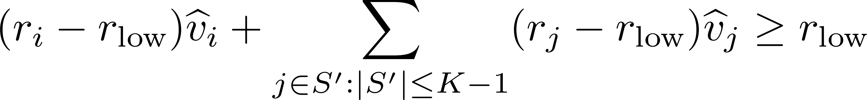
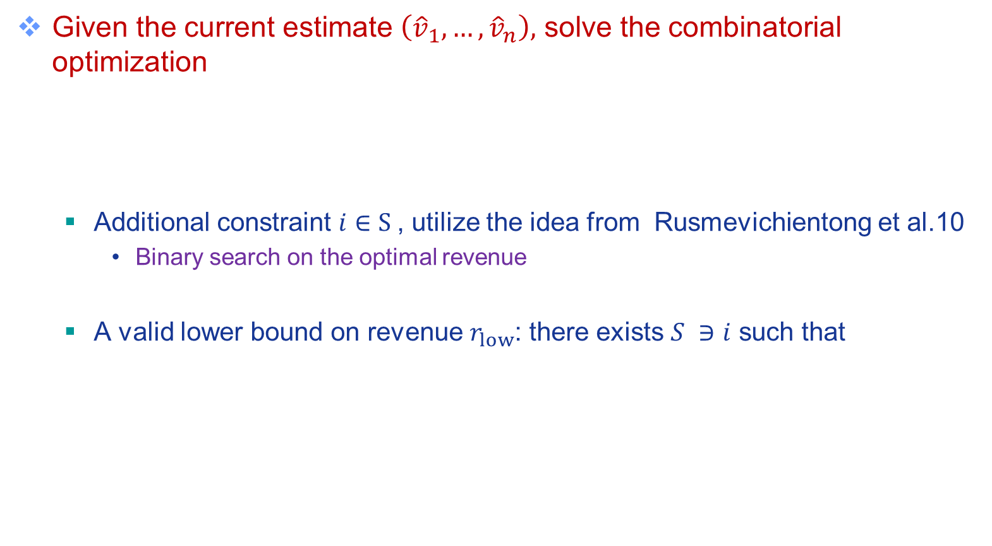
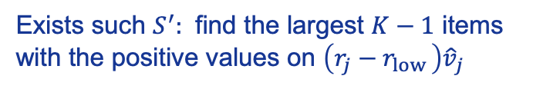
Efficient Optimization
Given the current estimate $\left({\hat{v}}_{1},…, {\hat{v}}_{n}\right),$ solve the combinatorial optimization
  Additional constraint $i∈S$, utilize the idea from Rusmevichientong et al.10
    Binary search on the optimal revenue
  A valid lower bound on revenue $r_{low}$: there exists $S ∋i$ such that
Exists such $S^{′}:$ find the largest $K−1$ items with the positive values on $\left(r_{j}−r_{low }\right){\hat{v}}_{j}$

Slide 18

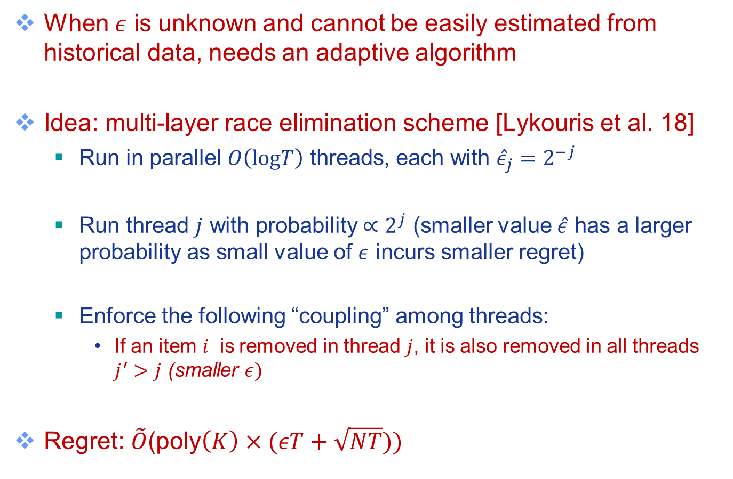
A Fully Adaptive Algorithm to $ε$
When $ε$ is unknown and cannot be easily estimated from historical data, needs an adaptive algorithm
Idea: multi-layer race elimination scheme [Lykouris et al. 18]
  Run in parallel $O\left(logT\right)$ threads, each with ${\hat{ε}}_{j}=2^{−j}$
  Run thread $j$ with probability $∝2^{j}$ (smaller value $\hat{ε}$ has a larger probability as small value of $ε$ incurs smaller regret)
  Enforce the following “coupling” among threads:
    If an item $i$ is removed in thread $j$, it is also removed in all threads $j^{′}>j$ (smaller $ε)$
Regret: $\tilde{O}$(poly$\left(K\right)×(εT+\sqrt{NT}))$
Notes:
If an assortment $S$ is provided in thread $j$, it will attain good reward in $j^{′}<j$ (larger $ε),meaning$

Slide 19
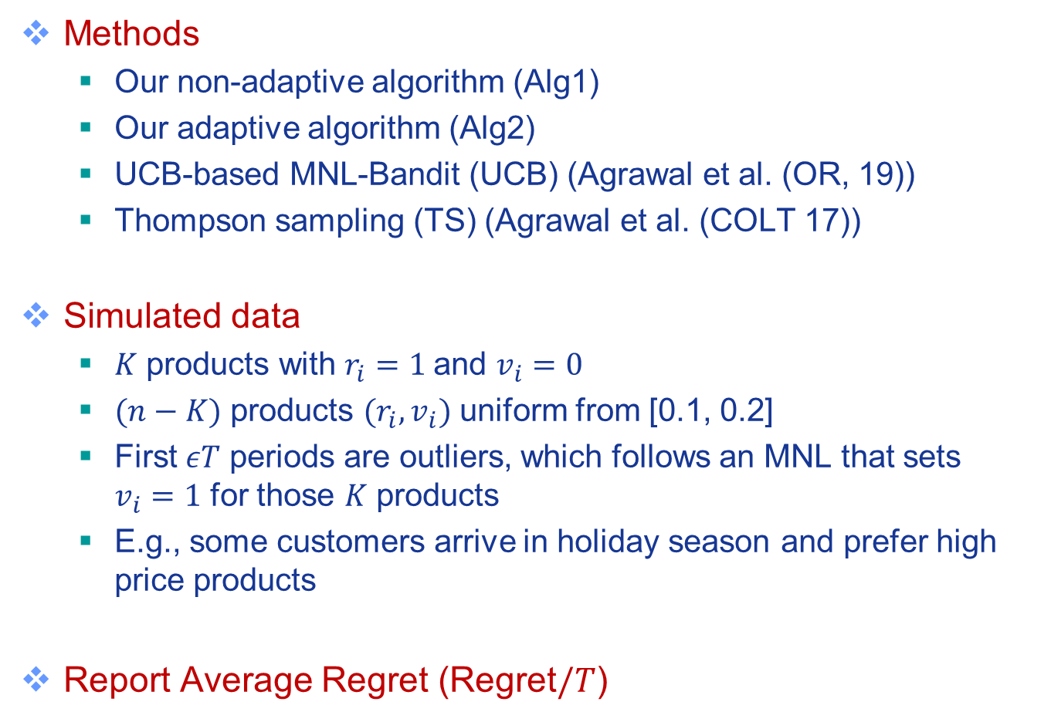
Experiment
Methods
  Our non-adaptive algorithm (Alg1)
  Our adaptive algorithm (Alg2)
  UCB-based MNL-Bandit (UCB) (Agrawal et al. (OR, 19))
  Thompson sampling (TS) (Agrawal et al. (COLT 17))
Simulated data
  $K$ products with $r_{i}=1$and $v_{i}=0$
  $(n−K)$ products $(r_{i}, v_{i})$ uniform from [0.1, 0.2]
  First $εT$ periods are outliers, which follows an MNL that sets $v_{i}=1$ for those $K$ products
  E.g., some customers arrive in holiday season and prefer high price products
Report Average Regret (Regret$/T$)

Slide 20
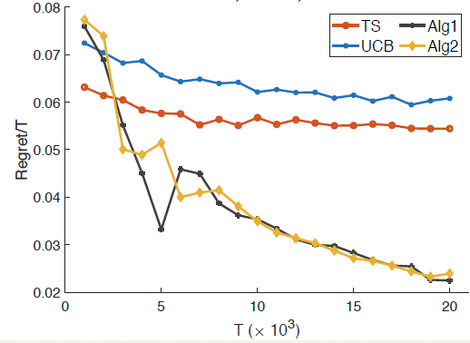
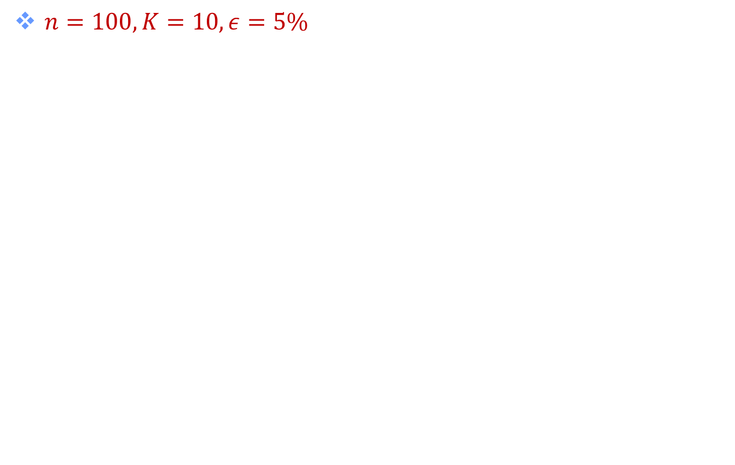
Experiment
$n=100, K=10, ε=5\%$

Slide 21
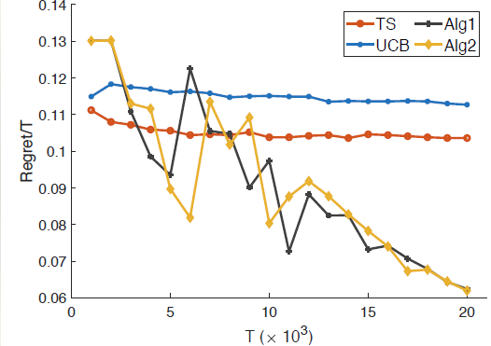
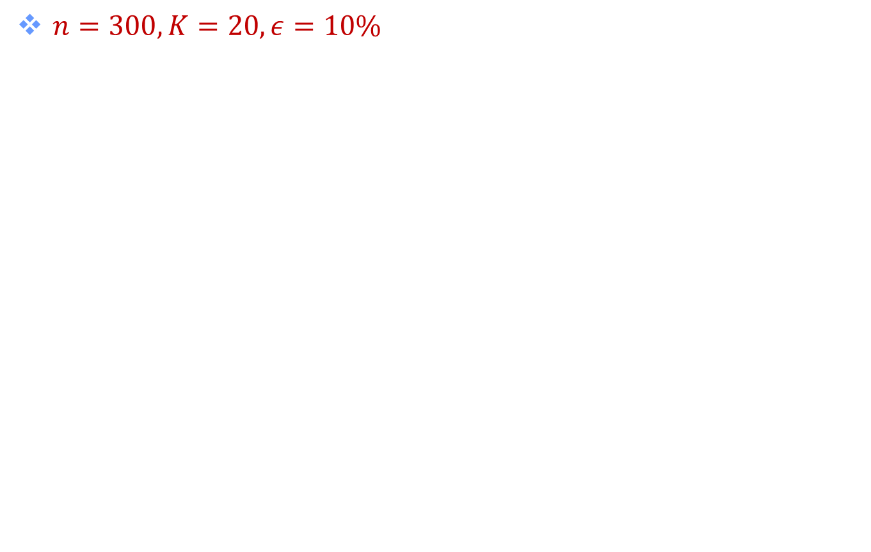
Experiment
$n=300, K=20, ε=10\%$

Slide 22
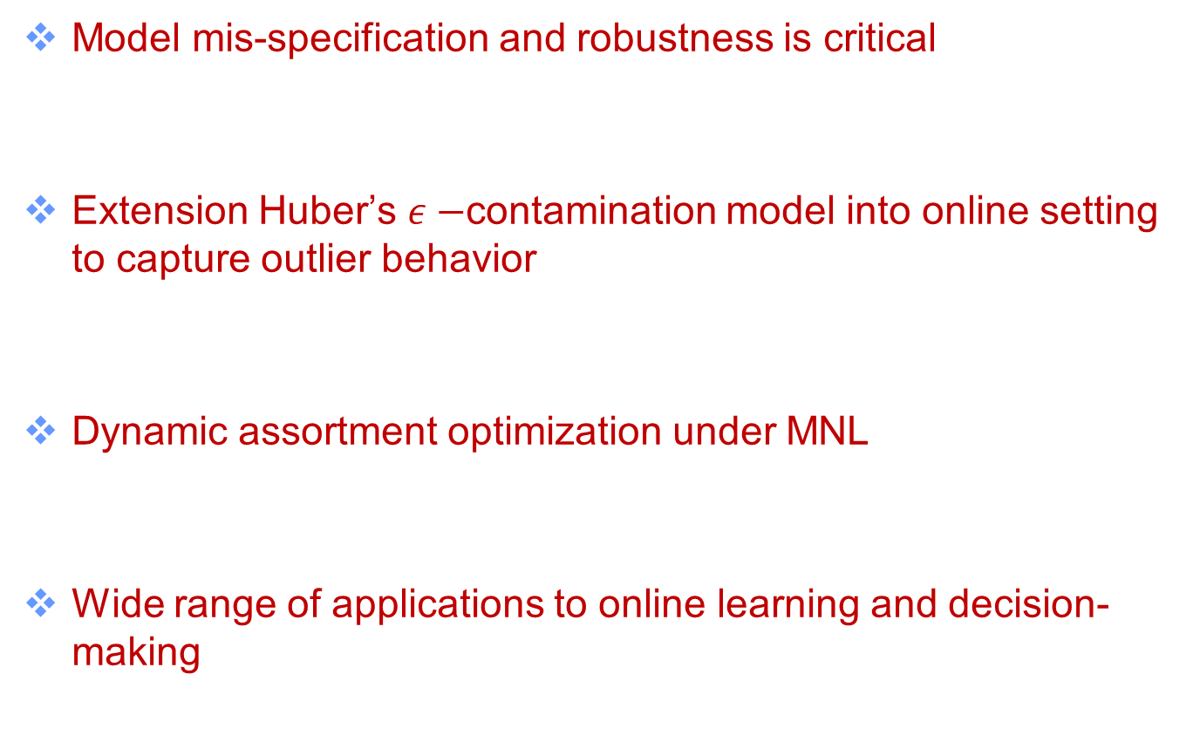
Conclusion
Model mis-specification and robustness is critical
Extension Huber’s $ε−$contamination model into online setting to capture outlier behavior
Dynamic assortment optimization under MNL
Wide range of applications to online learning and decision-making

Slide 23
Thank You!
Q&A

