Slide 1


Network Revenue Management with
Nonparametric Demand Learning: sqrt{T}-regret and Polynomial Dimension Dependency
Sentao Miao
Desautels Faculty of Management, McGill University
Yining wANG
Naveen Jindal school of management, University of Texas dallas

Slide 2







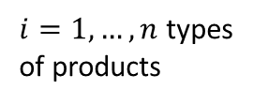

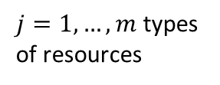
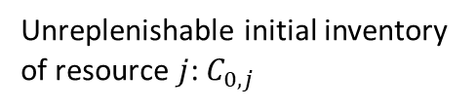
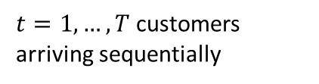
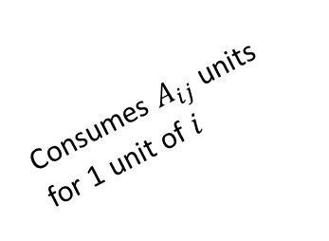

A classical NRM problem with demand learning
Consumes $A_{ij}$ units for 1 unit of $i$
Price: $p_{ti}$
……
Unreplenishable initial inventory
of resource $j$: $C_{0,j}$
Demand: $d_{ti}$
$t=1,…,T$customers arriving sequentially
$j=1,…,m$ types of resources
$i=1,…,n$ types of products

Slide 3
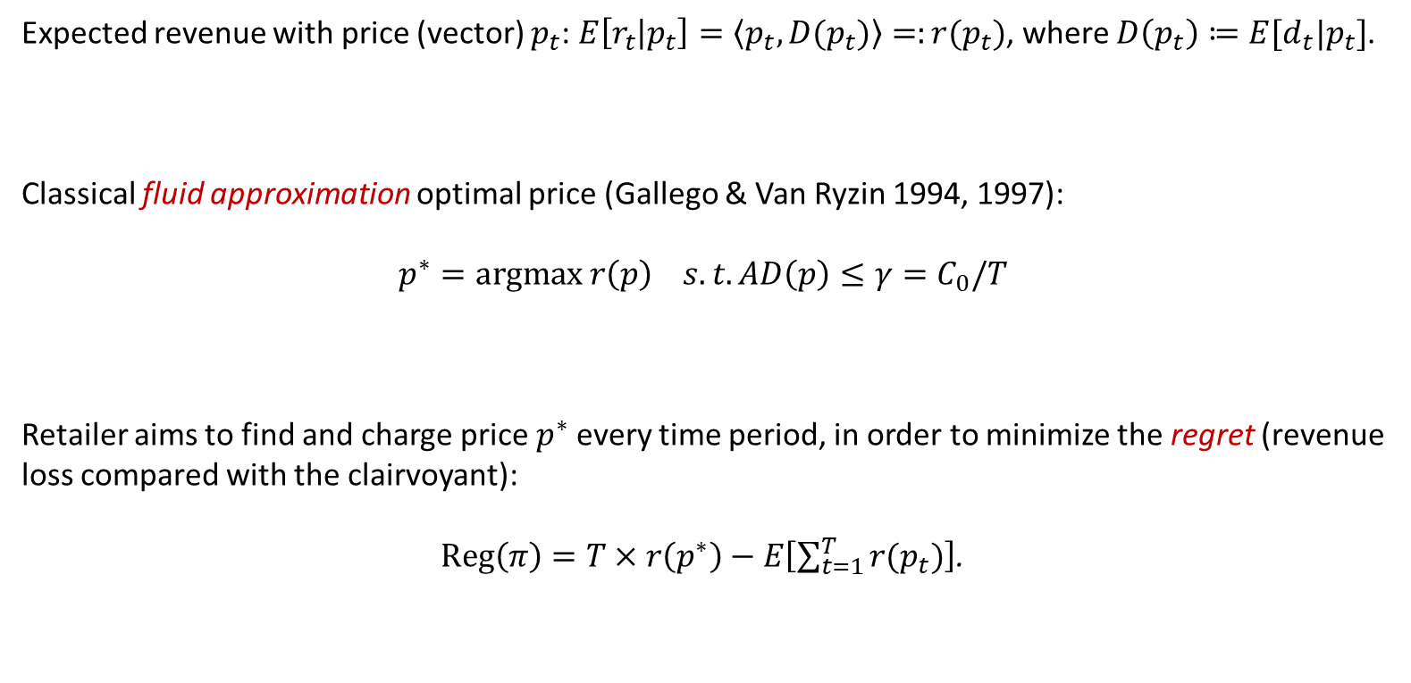
Retailer aims to maximize cumulative revenue with unknown demand
Expected revenue with price (vector) $p_{t}$: $E\left[r_{t} | p_{t}\right]=\left\langle p_{t}, D(p_{t})\right\rangle =:r(p_{t})$, where $D\left(p_{t}\right)≔E[d_{t}|p_{t}]$.
Classical fluid approximation optimal price (Gallego & Van Ryzin 1994, 1997):
$$p^{∗}=argmax r\left(p\right) s.t. AD\left(p\right)≤γ=C_{0}/T$$
Retailer aims to find and charge price $p^{∗}$ every time period, in order to minimize the regret (revenue loss compared with the clairvoyant):
$Reg\left(π\right)=T×r\left(p^{∗}\right)−E\left[\sum_{t=1}^{T}{r(p_{t})}\right]$.

Slide 4
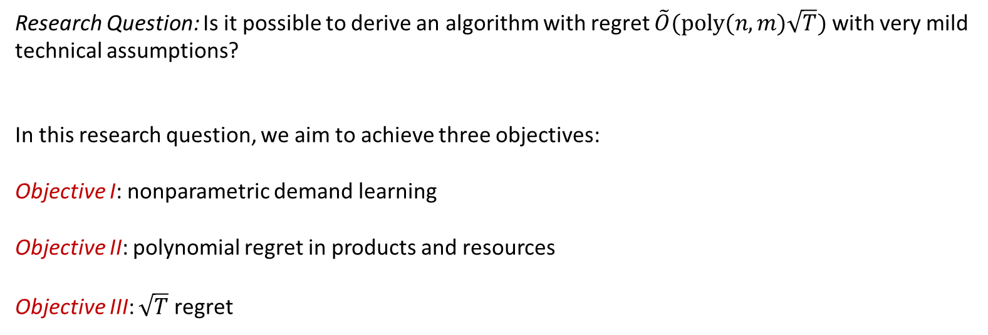
Our research question includes three objectives
Research Question: Is it possible to derive an algorithm with regret $\tilde{O}(poly(n,m)\sqrt{T})$ with very mild technical assumptions?
In this research question, we aim to achieve three objectives:
Objective I: nonparametric demand learning
Objective II: polynomial regret in products and resources
Objective III: $\sqrt{T}$ regret

Slide 5



Many applications of NRM in real life

Slide 6
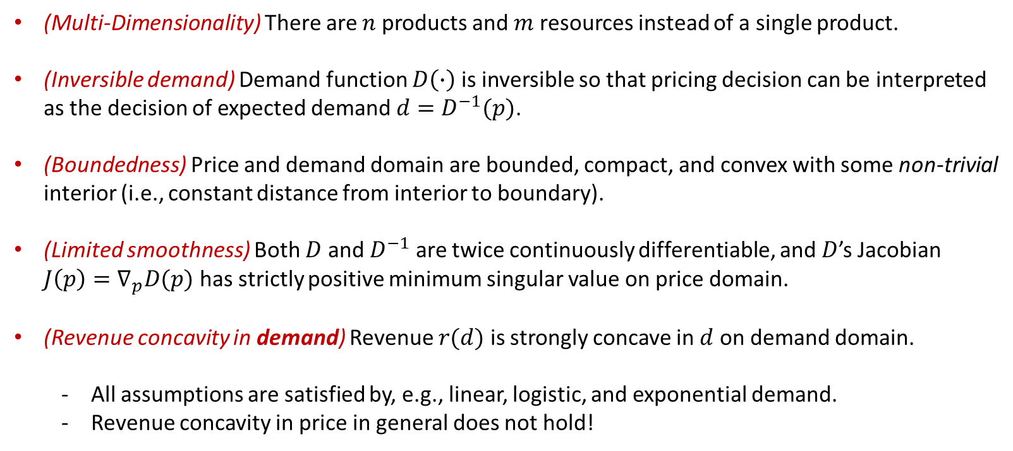
This problem becomes difficult with very mild technical assumptions
(Multi-Dimensionality) There are $n$ products and $m$ resources instead of a single product.
(Inversible demand) Demand function $D\left(∙\right)$ is inversible so that pricing decision can be interpreted as the decision of expected demand $d=D^{−1}(p)$.
(Boundedness) Price and demand domain are bounded, compact, and convex with some non-trivial interior (i.e., constant distance from interior to boundary).
(Limited smoothness) Both $D$ and $D^{−1}$ are twice continuously differentiable, and $D$’s Jacobian $J\left(p\right)=∇_{p}D(p)$ has strictly positive minimum singular value on price domain.
(Revenue concavity in demand) Revenue $r(d)$ is strongly concave in $d$ on demand domain.
  All assumptions are satisfied by, e.g., linear, logistic, and exponential demand.
  Revenue concavity in price in general does not hold!

Slide 7
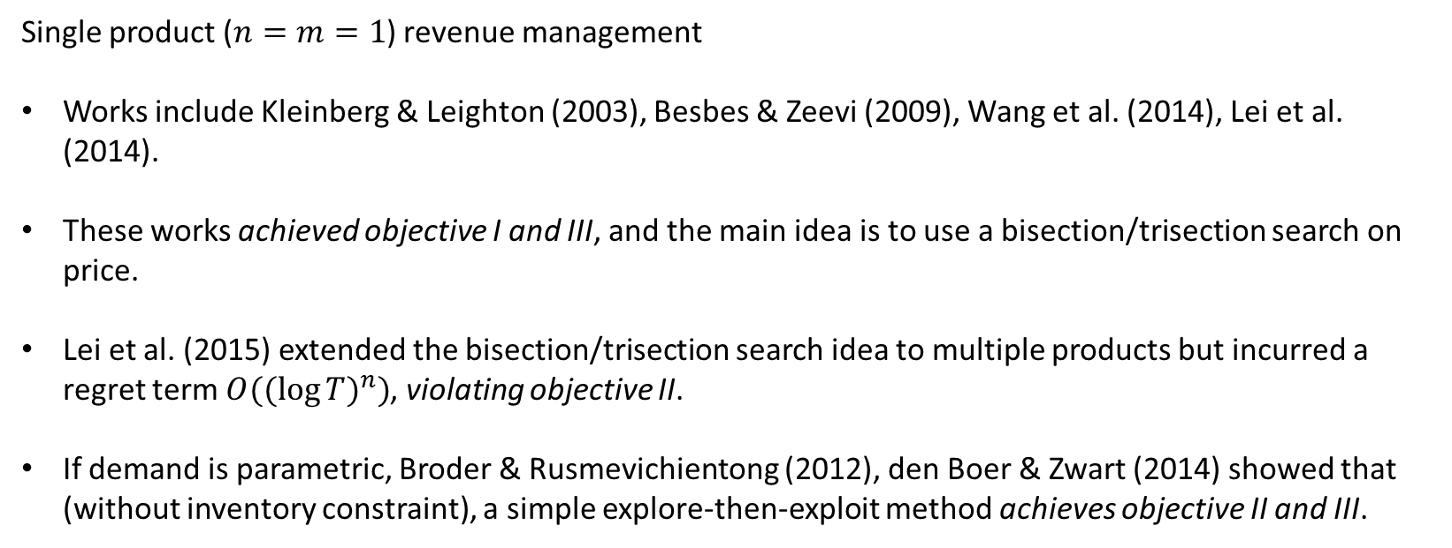
Previous efforts of solving this problem
Single product ($n=m=1$) revenue management
Works include Kleinberg & Leighton (2003), Besbes & Zeevi (2009), Wang et al. (2014), Lei et al. (2014).
These works achieved objective I and III, and the main idea is to use a bisection/trisection search on price.
Lei et al. (2015) extended the bisection/trisection search idea to multiple products but incurred a regret term $O({(\log{T})}^{n})$, violating objective II.
If demand is parametric, Broder & Rusmevichientong (2012), den Boer & Zwart (2014) showed that (without inventory constraint), a simple explore-then-exploit method achieves objective II and III.

Slide 8
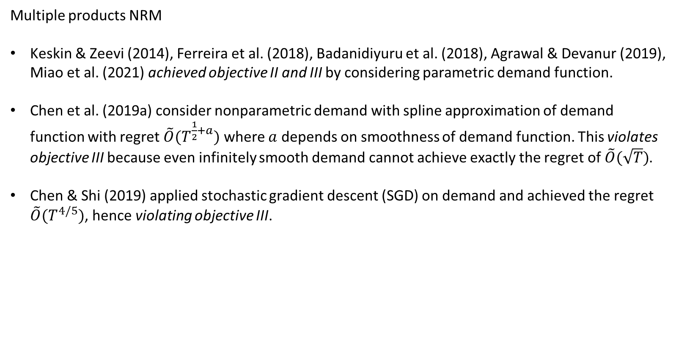
Previous efforts of solving this problem
Multiple products NRM
Keskin & Zeevi (2014), Ferreira et al. (2018), Badanidiyuru et al. (2018), Agrawal & Devanur (2019), Miao et al. (2021) achieved objective II and III by considering parametric demand function.
Chen et al. (2019a) consider nonparametric demand with spline approximation of demand function with regret $\tilde{O}(T^{\frac{1}{2}+a})$ where $a$ depends on smoothness of demand function. This violates objective III because even infinitely smooth demand cannot achieve exactly the regret of $\tilde{O}(\sqrt{T})$.
Chen & Shi (2019) applied stochastic gradient descent (SGD) on demand and achieved the regret $\tilde{O}(T^{4/5})$, hence violating objective III.

Slide 9
Summary of methods used in previous literature
Bisection/Trisection search on price
  Cannot be easily extended to multiple products.
Functional approximation
  Highly depends on smoothness of demand function.
Parameter estimation and UCB algorithm
  Cannot work on nonparametric demand function.
SGD on price
  Revenue is not concave in price so no convergence guarantee.
SGD on demand
  No direct control of demand, hence no unbiased estimation of the gradient.

Slide 10
Summary of methods used in previous literature
Bisection/Trisection search on price
  Cannot be easily extended to multiple products.
Functional approximation
  Highly depends on smoothness of demand function.
Parameter estimation and UCB algorithm
  Cannot work on nonparametric demand function.
SGD on price
  Revenue is not concave in price so no convergence guarantee.
SGD on demand
  No direct control of demand, hence no unbiased estimation of the gradient.

Slide 11
Summary of methods used in previous literature
Is there some “high dimensional version” of bisection search?
Bisection/Trisection search on price
  Cannot be easily extended to multiple products.
Functional approximation
  Highly depends on smoothness of demand function.
Parameter estimation and UCB algorithm
  Cannot work on nonparametric demand function.
SGD on price
  Revenue is not concave in price so no convergence guarantee.
SGD on demand
  No direct control of demand, hence no unbiased estimation of the gradient.

Slide 12
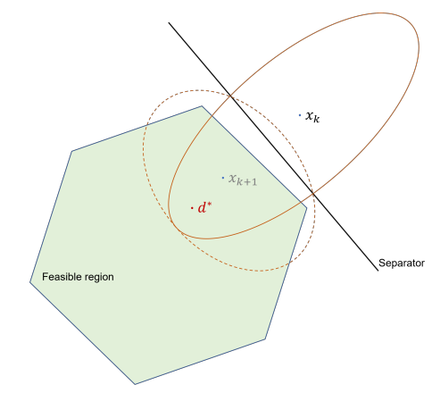
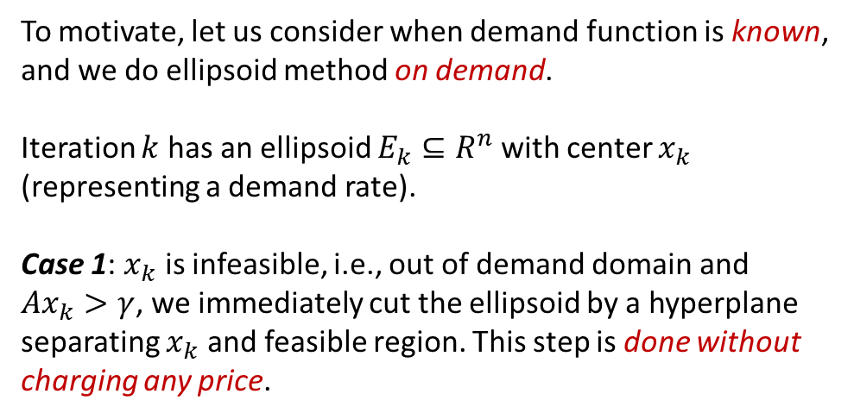
My (unpopular) opinion: ellipsoid method is a somewhat “high dimensional bisection search”
To motivate, let us consider when demand function is known, and we do ellipsoid method on demand.
Iteration $k$ has an ellipsoid $E_{k}⊆R^{n}$ with center $x_{k}$ (representing a demand rate).
Case 1: $x_{k}$ is infeasible, i.e., out of demand domain and $Ax_{k}>γ$, we immediately cut the ellipsoid by a hyperplane separating $x_{k}$ and feasible region. This step is done without charging any price.

Slide 13
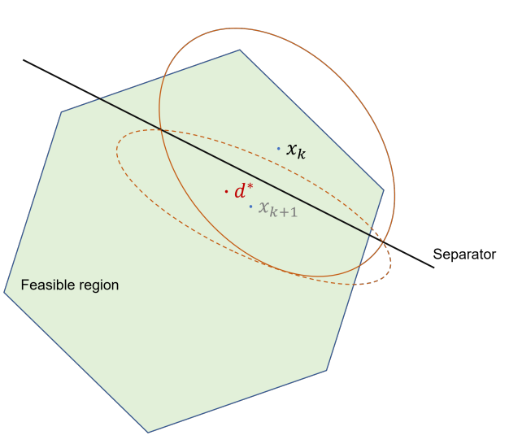
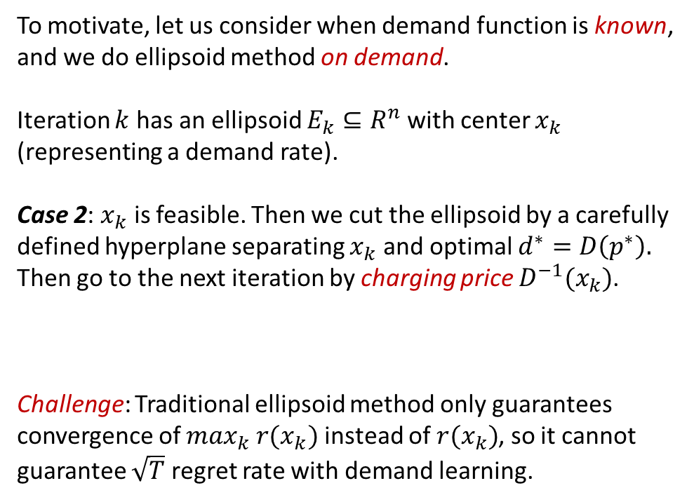
My (unpopular) opinion: ellipsoid method is a somewhat “high dimensional bisection search”
To motivate, let us consider when demand function is known, and we do ellipsoid method on demand.
Iteration $k$ has an ellipsoid $E_{k}⊆R^{n}$ with center $x_{k}$ (representing a demand rate).
Case 2: $x_{k}$ is feasible. Then we cut the ellipsoid by a carefully defined hyperplane separating $x_{k}$ and optimal $d^{∗}=D\left(p^{∗}\right).$ Then go to the next iteration by charging price $D^{−1}(x_{k})$.
Challenge: Traditional ellipsoid method only guarantees convergence of $\max_{k} r(x_{k})$ instead of $r(x_{k})$, so it cannot guarantee $\sqrt{T}$ regret rate with demand learning.

Slide 14
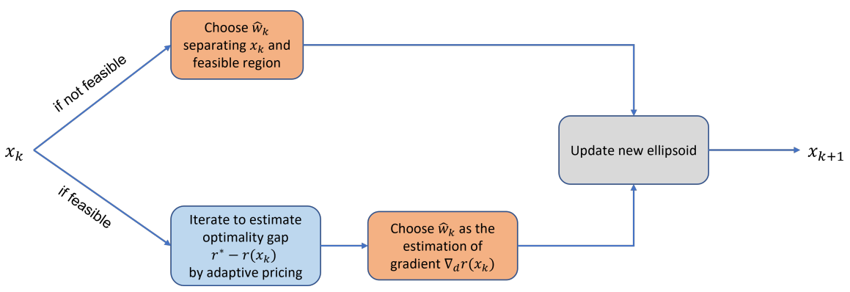
Our algorithm: a robust ellipsoid method for NRM with nonparametric demand

Slide 15
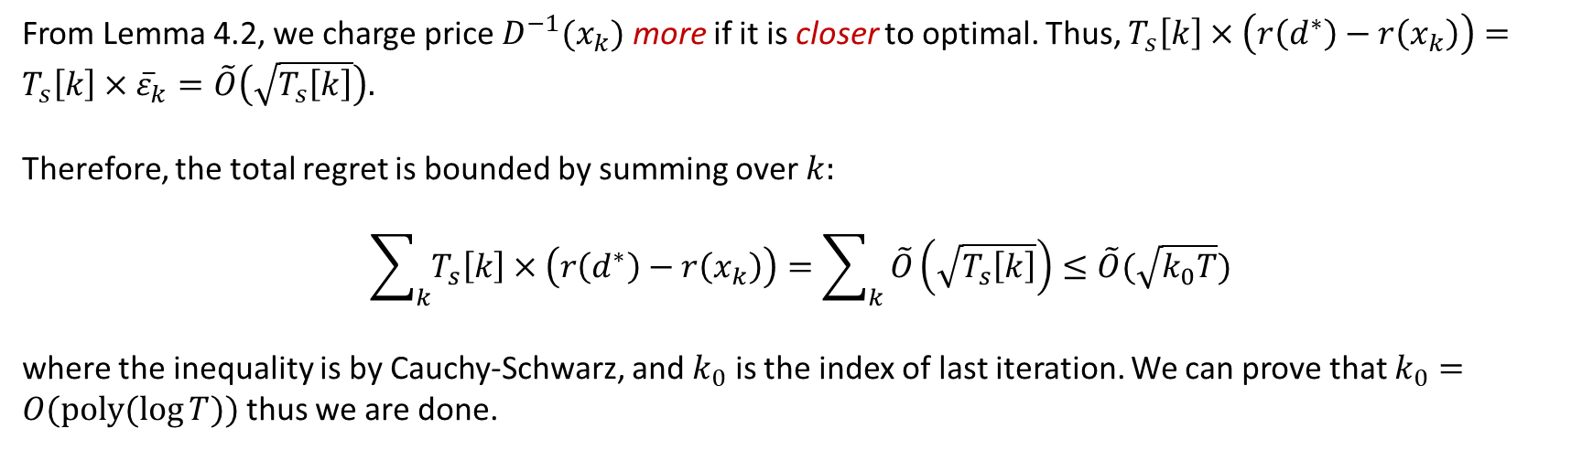
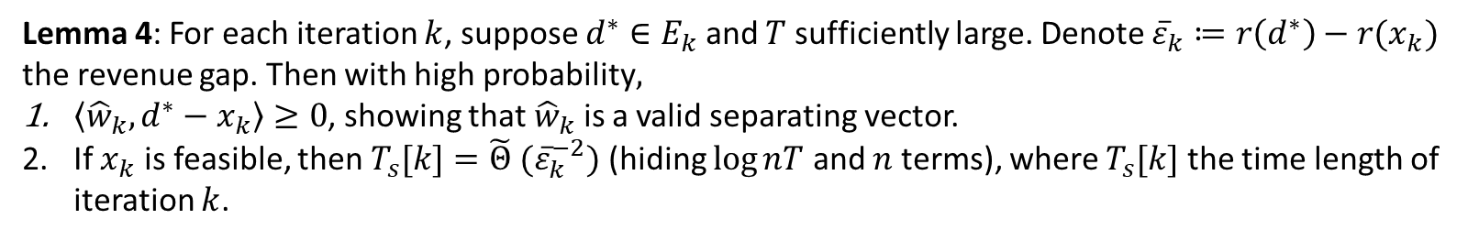
The high-level idea why our algorithm works
Lemma 4: For each iteration $k$, suppose $d^{∗}∈E_{k}$ and $T$ sufficiently large. Denote ${\overline{ε}}_{k}≔r\left(d^{∗}\right)−r(x_{k})$ the revenue gap. Then with high probability$,$
$\left\langle {\hat{w}}_{k}, d^{∗}−x_{k}\right\rangle ≥0$, showing that ${\hat{w}}_{k}$ is a valid separating vector.
If $x_{k}$ is feasible, then $T_{s}[k]={\tilde{Θ} (\overline{ε}}_{k}^{−2})$ (hiding $\log{nT}$ and $n$ terms), where $T_{s}[k]$ the time length of iteration $k$.
From Lemma 4.2, we charge price $D^{−1}(x_{k})$ more if it is closer to optimal. Thus, $T_{s}\left[k\right]×\left(r\left(d^{∗}\right)−r\left(x_{k}\right)\right)=T_{s}\left[k\right]×{\overline{ε}}_{k}=\tilde{O}\left(\sqrt{T_{s}\left[k\right]}\right).$
Therefore, the total regret is bounded by summing over $k:$
$$\sum_{k}{T_{s}\left[k\right]×\left(r\left(d^{∗}\right)−r\left(x_{k}\right)\right)}=\sum_{k}{\tilde{O}\left(\sqrt{T_{s}\left[k\right]}\right)≤\tilde{O}(\sqrt{k_{0}T})}$$
where the inequality is by Cauchy-Schwarz, and $k_{0}$ is the index of last iteration. We can prove that $k_{0}=O(poly(\log{T}))$ thus we are done.

Slide 16
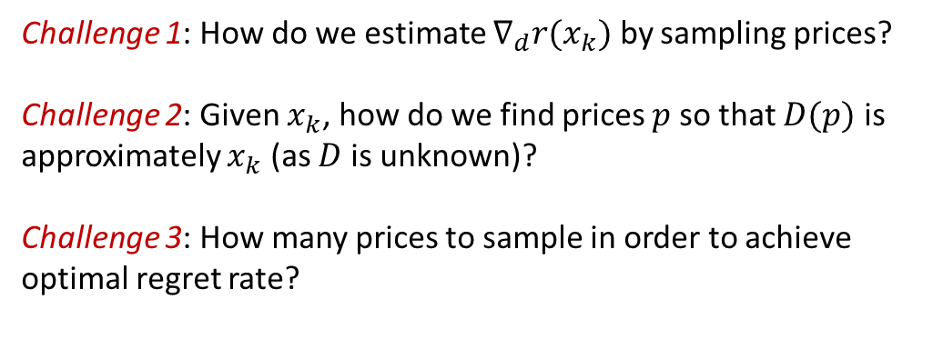
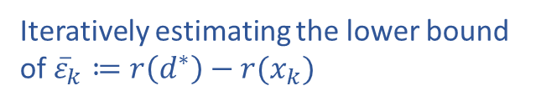

Key challenges of our algorithm
Subroutine 1: Estimating gradient/Jacobian at $p$
Challenge 1: How do we estimate $∇_{d}r(x_{k})$ by sampling prices?
Challenge 2: Given $x_{k}$, how do we find prices $p$ so that $D(p)$ is approximately $x_{k}$ (as $D$ is unknown)?
Challenge 3: How many prices to sample in order to achieve optimal regret rate?
Subroutine 2: Price search
Iteratively estimating the lower bound
of ${\overline{ε}}_{k}≔r\left(d^{∗}\right)−r(x_{k})$

Slide 17
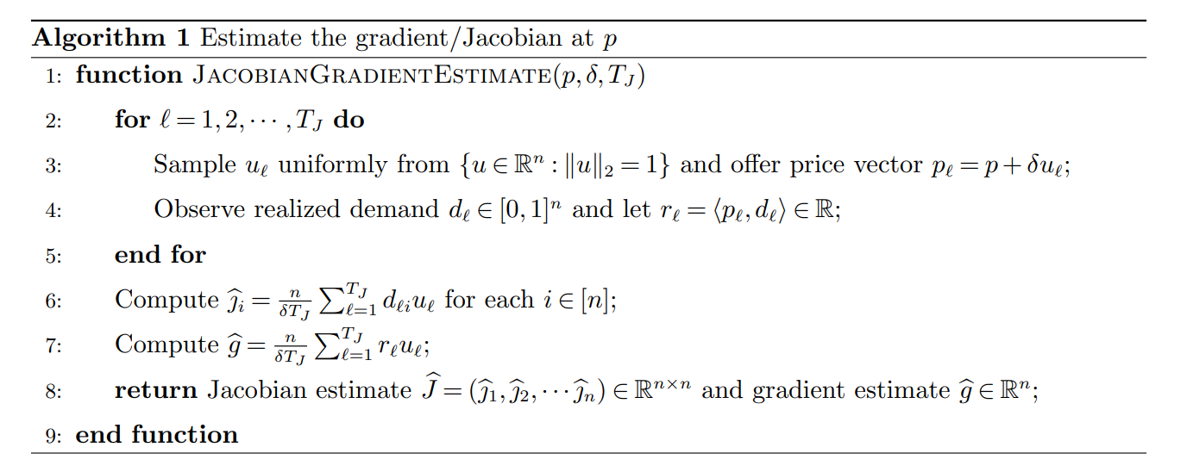
Subroutine 1: Estimating gradient/Jacobian at 𝑝
This subroutine estimates the Jacobian $J=∇_{p}D$ and the gradient $∇_{p}r$ by randomly sampling prices (see e.g., Nemirovskij & Yudin 1983, Flaxman et al. 2005).
Lemma 1: With high probability, the estimation errors of $J, J^{−1},∇_{p}r$ are bounded by $\tilde{O}\left(\sqrt{n}\left(nδ^{−1}T_{J}^{−\frac{1}{2}}+δ^{2}\right)\right).$

Slide 18
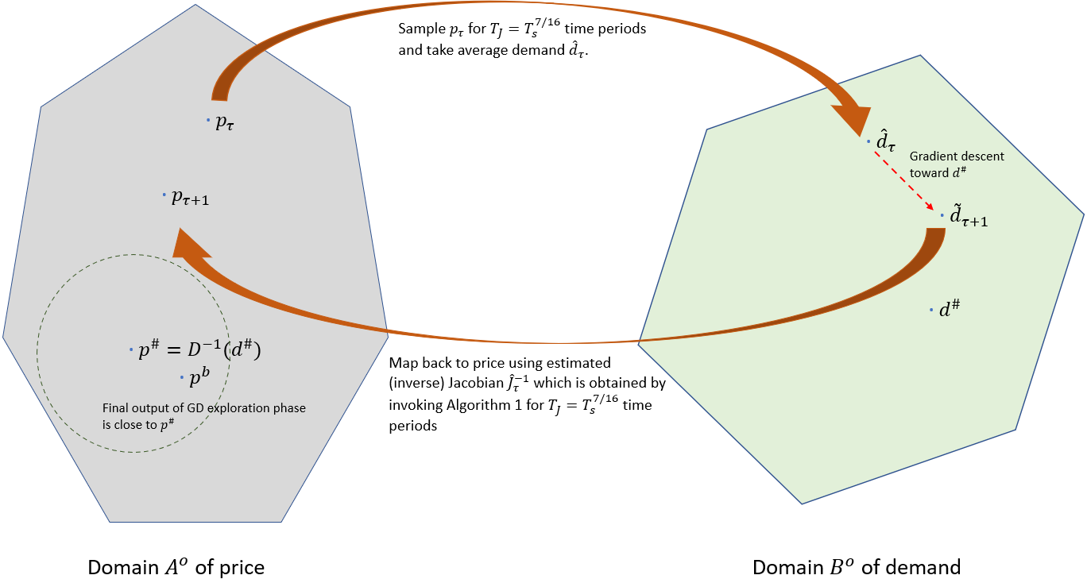
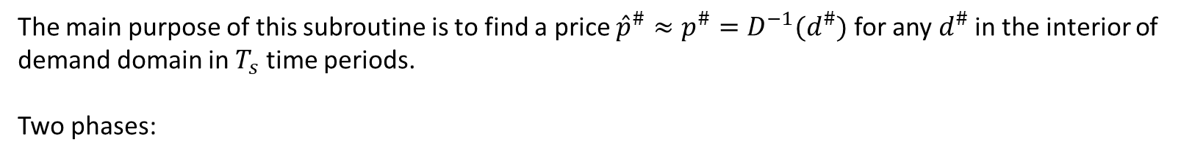
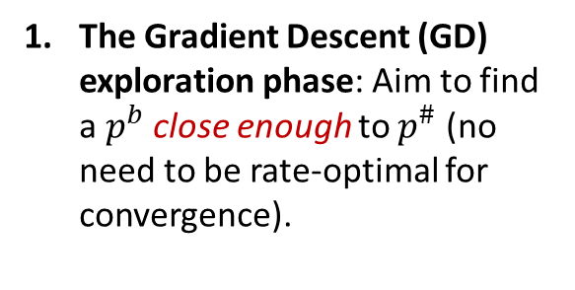
Subroutine 2: Price Search
The main purpose of this subroutine is to find a price ${\hat{p}}^{\#}≈p^{\#}=D^{−1}(d^{\#})$ for any $d^{\#}$ in the interior of demand domain in $T_{s}$ time periods.
Two phases:
The Gradient Descent (GD) exploration phase: Aim to find a $p^{b}$ close enough to $p^{\#}$ (no need to be rate-optimal for convergence).

Slide 19
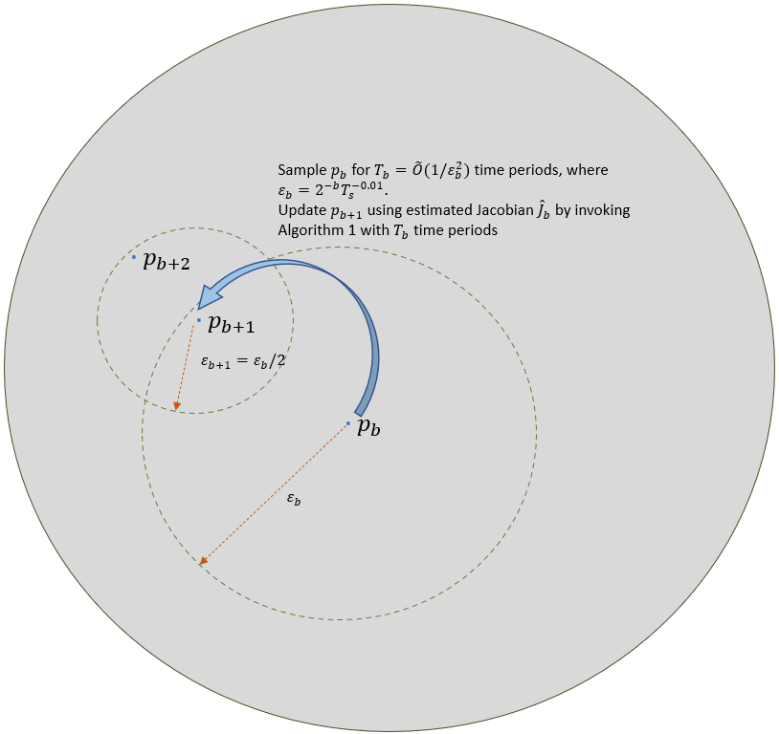
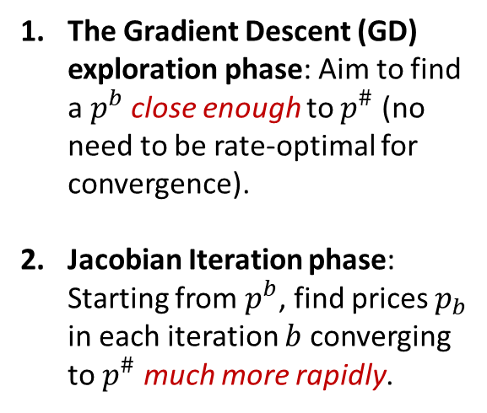
Subroutine 2: Price Search
The main purpose of this subroutine is to find a price ${\hat{p}}^{\#}≈p^{\#}=D^{−1}(d^{\#})$ for any $d^{\#}$ in the interior of demand domain in $T_{s}$ time periods.
Two phases:
The Gradient Descent (GD) exploration phase: Aim to find a $p^{b}$ close enough to $p^{\#}$ (no need to be rate-optimal for convergence).
Jacobian Iteration phase: Starting from $p^{b}$, find prices $p_{b}$ in each iteration $b$ converging to $p^{\#}$ much more rapidly.

Slide 20
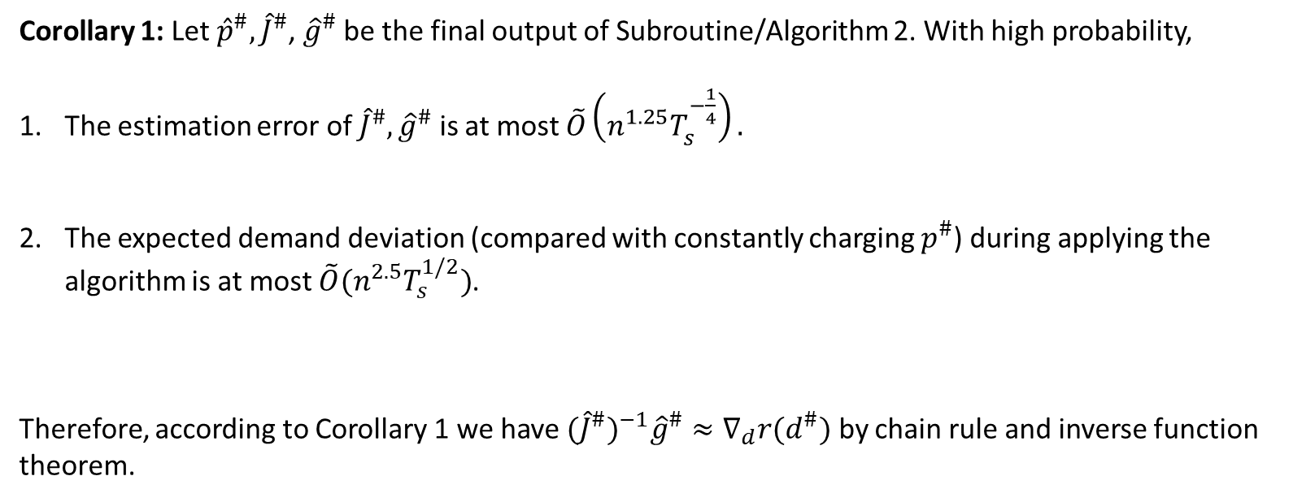
Subroutine 2 guarantees sufficient accuracy of estimated price, Jacobian, and gradient
Corollary 1: Let ${\hat{p}}^{\#},{\hat{J}}^{\#}$, ${\hat{g}}^{\#}$ be the final output of Subroutine/Algorithm 2. With high probability,
The estimation error of ${\hat{J}}^{\#},{\hat{g}}^{\#}$ is at most $\tilde{O}\left(n^{1.25}T_{s}^{−\frac{1}{4}}\right).$
The expected demand deviation (compared with constantly charging $p^{\#}$) during applying the algorithm is at most $\tilde{O}(n^{2.5}T_{s}^{1/2})$.
Therefore, according to Corollary 1 we have ${(\hat{J}}^{\#})^{−1}{\hat{g}}^{\#}≈∇_{d}r(d^{\#})$ by chain rule and inverse function theorem.

Slide 21
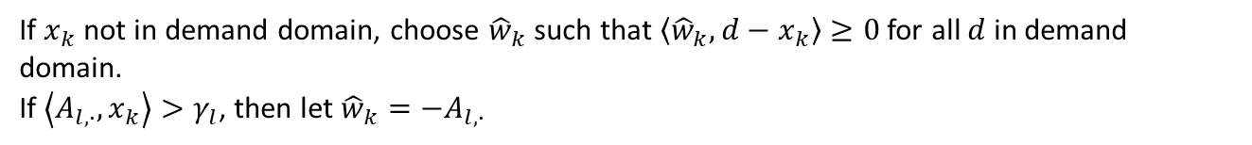
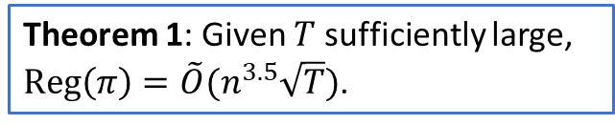
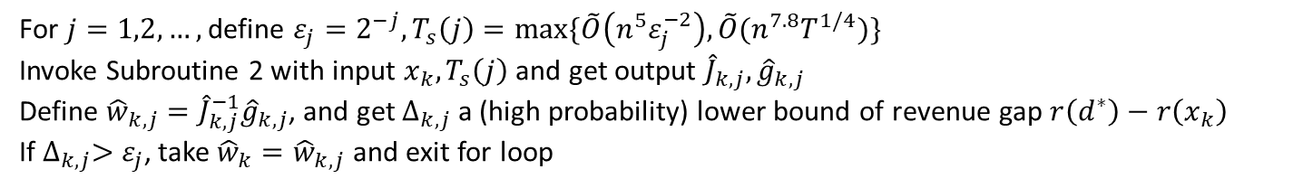
Our algorithm: a robust ellipsoid method for NRM with nonparametric demand
If $x_{k}$ not in demand domain, choose ${\hat{w}}_{k}$ such that $\left\langle {\hat{w}}_{k},d−x_{k}\right\rangle ≥0$ for all $d$ in demand domain.
If $\left\langle A_{l,∙},x_{k}\right\rangle >γ_{l}$, then let ${\hat{w}}_{k}=−A_{l,∙}$
Theorem 1: Given $T$ sufficiently large, $Reg\left(π\right)=\tilde{O}(n^{3.5}\sqrt{T})$.
For $j=1,2,…,$ define $ε_{j}=2^{−j}, T_{s}\left(j\right)=max⁡\{\tilde{O}\left(n^{5}ε_{j}^{−2}\right),\tilde{O}(n^{7.8}T^{1/4})\}$
Invoke Subroutine 2 with input $x_{k},T_{s}\left(j\right)$ and get output ${\hat{J}}_{k,j},{\hat{g}}_{k,j}$
Define ${\hat{w}}_{k,j}={\hat{J}}_{k,j}^{−1}{\hat{g}}_{k,j}$, and get $∆_{k,j}$ a (high probability) lower bound of revenue gap $r\left(d^{∗}\right)−r\left(x_{k}\right)$
If $∆_{k,j}>$ $ε_{j}$, take ${\hat{w}}_{k}={\hat{w}}_{k,j}$ and exit for loop

Slide 22
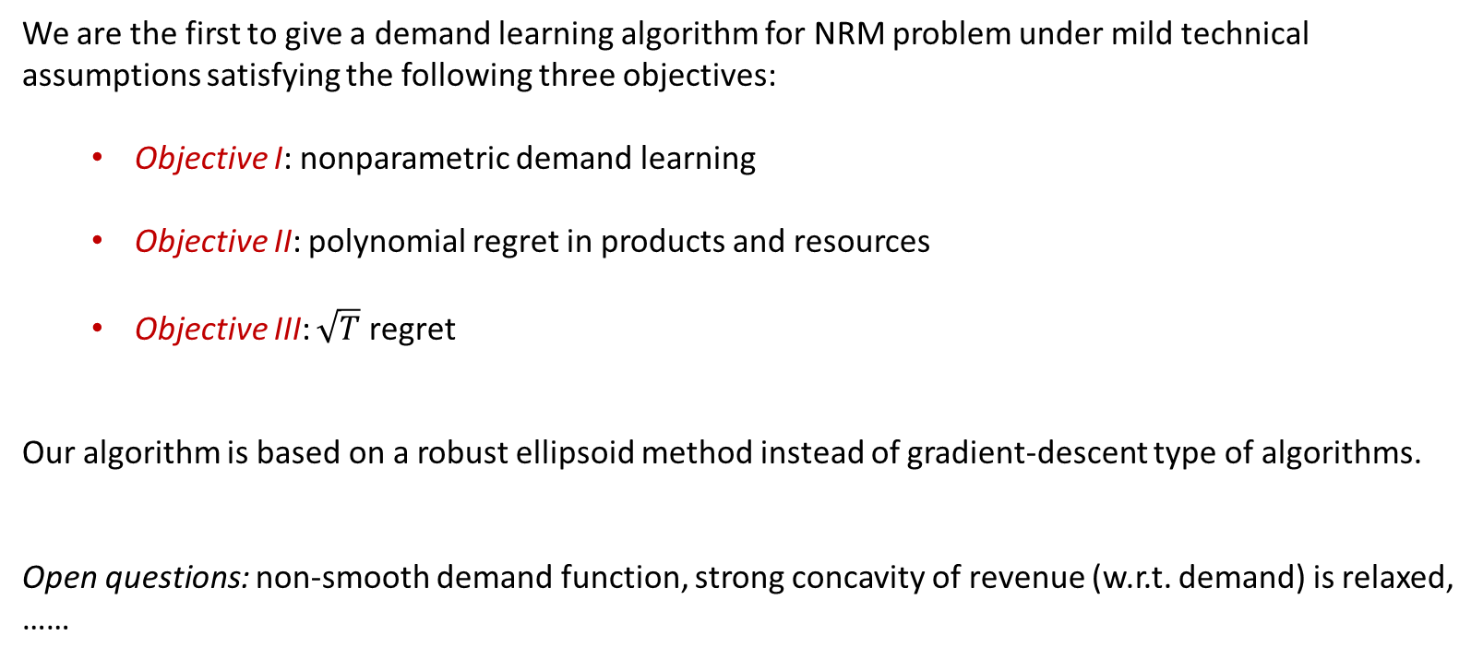
Conclusion and more open questions
We are the first to give a demand learning algorithm for NRM problem under mild technical assumptions satisfying the following three objectives:
  Objective I: nonparametric demand learning
  Objective II: polynomial regret in products and resources
  Objective III: $\sqrt{T}$ regret
Our algorithm is based on a robust ellipsoid method instead of gradient-descent type of algorithms.
Open questions: non-smooth demand function, strong concavity of revenue (w.r.t. demand) is relaxed, ……

Slide 23
Thank you!
Comments and questions?
Email: sentao.miao@mcgill.ca

